Slide 1
Apollo Renal Therapeutics Water Filtration Project
Team 504
Kencin Autry, Matthew Kennedy, Timothy Norman,
Lapadre Proctor, Lily Thompson

Slide 2
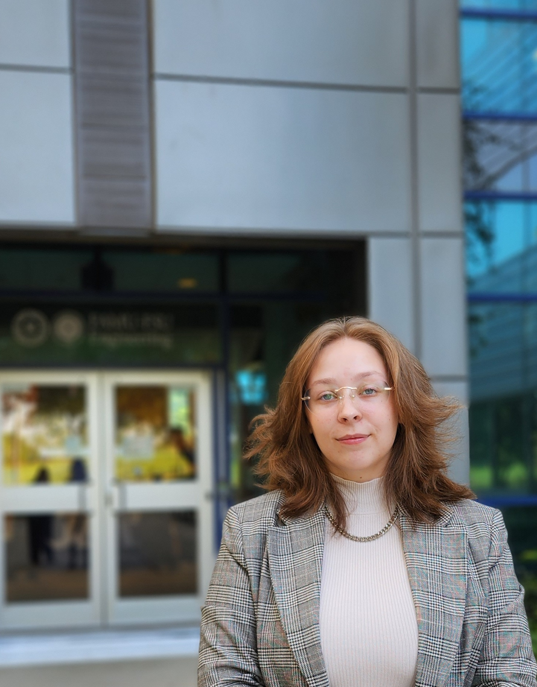
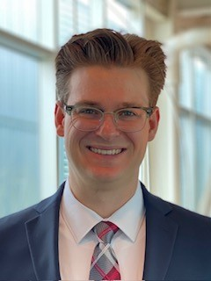
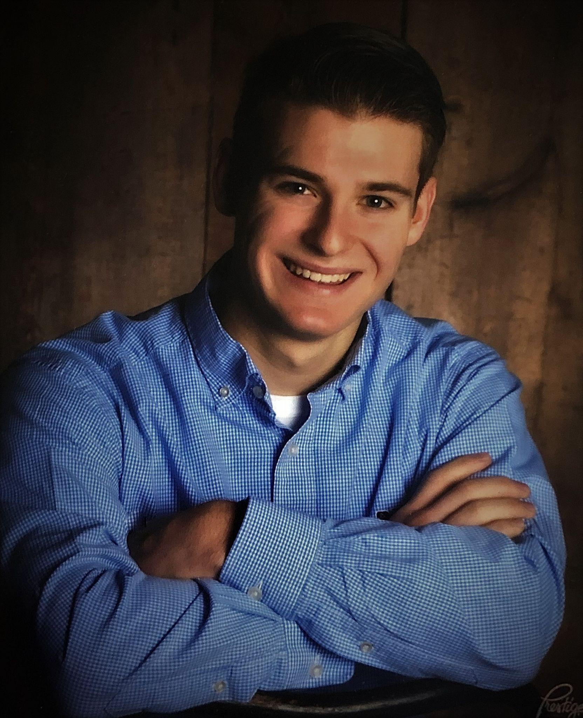
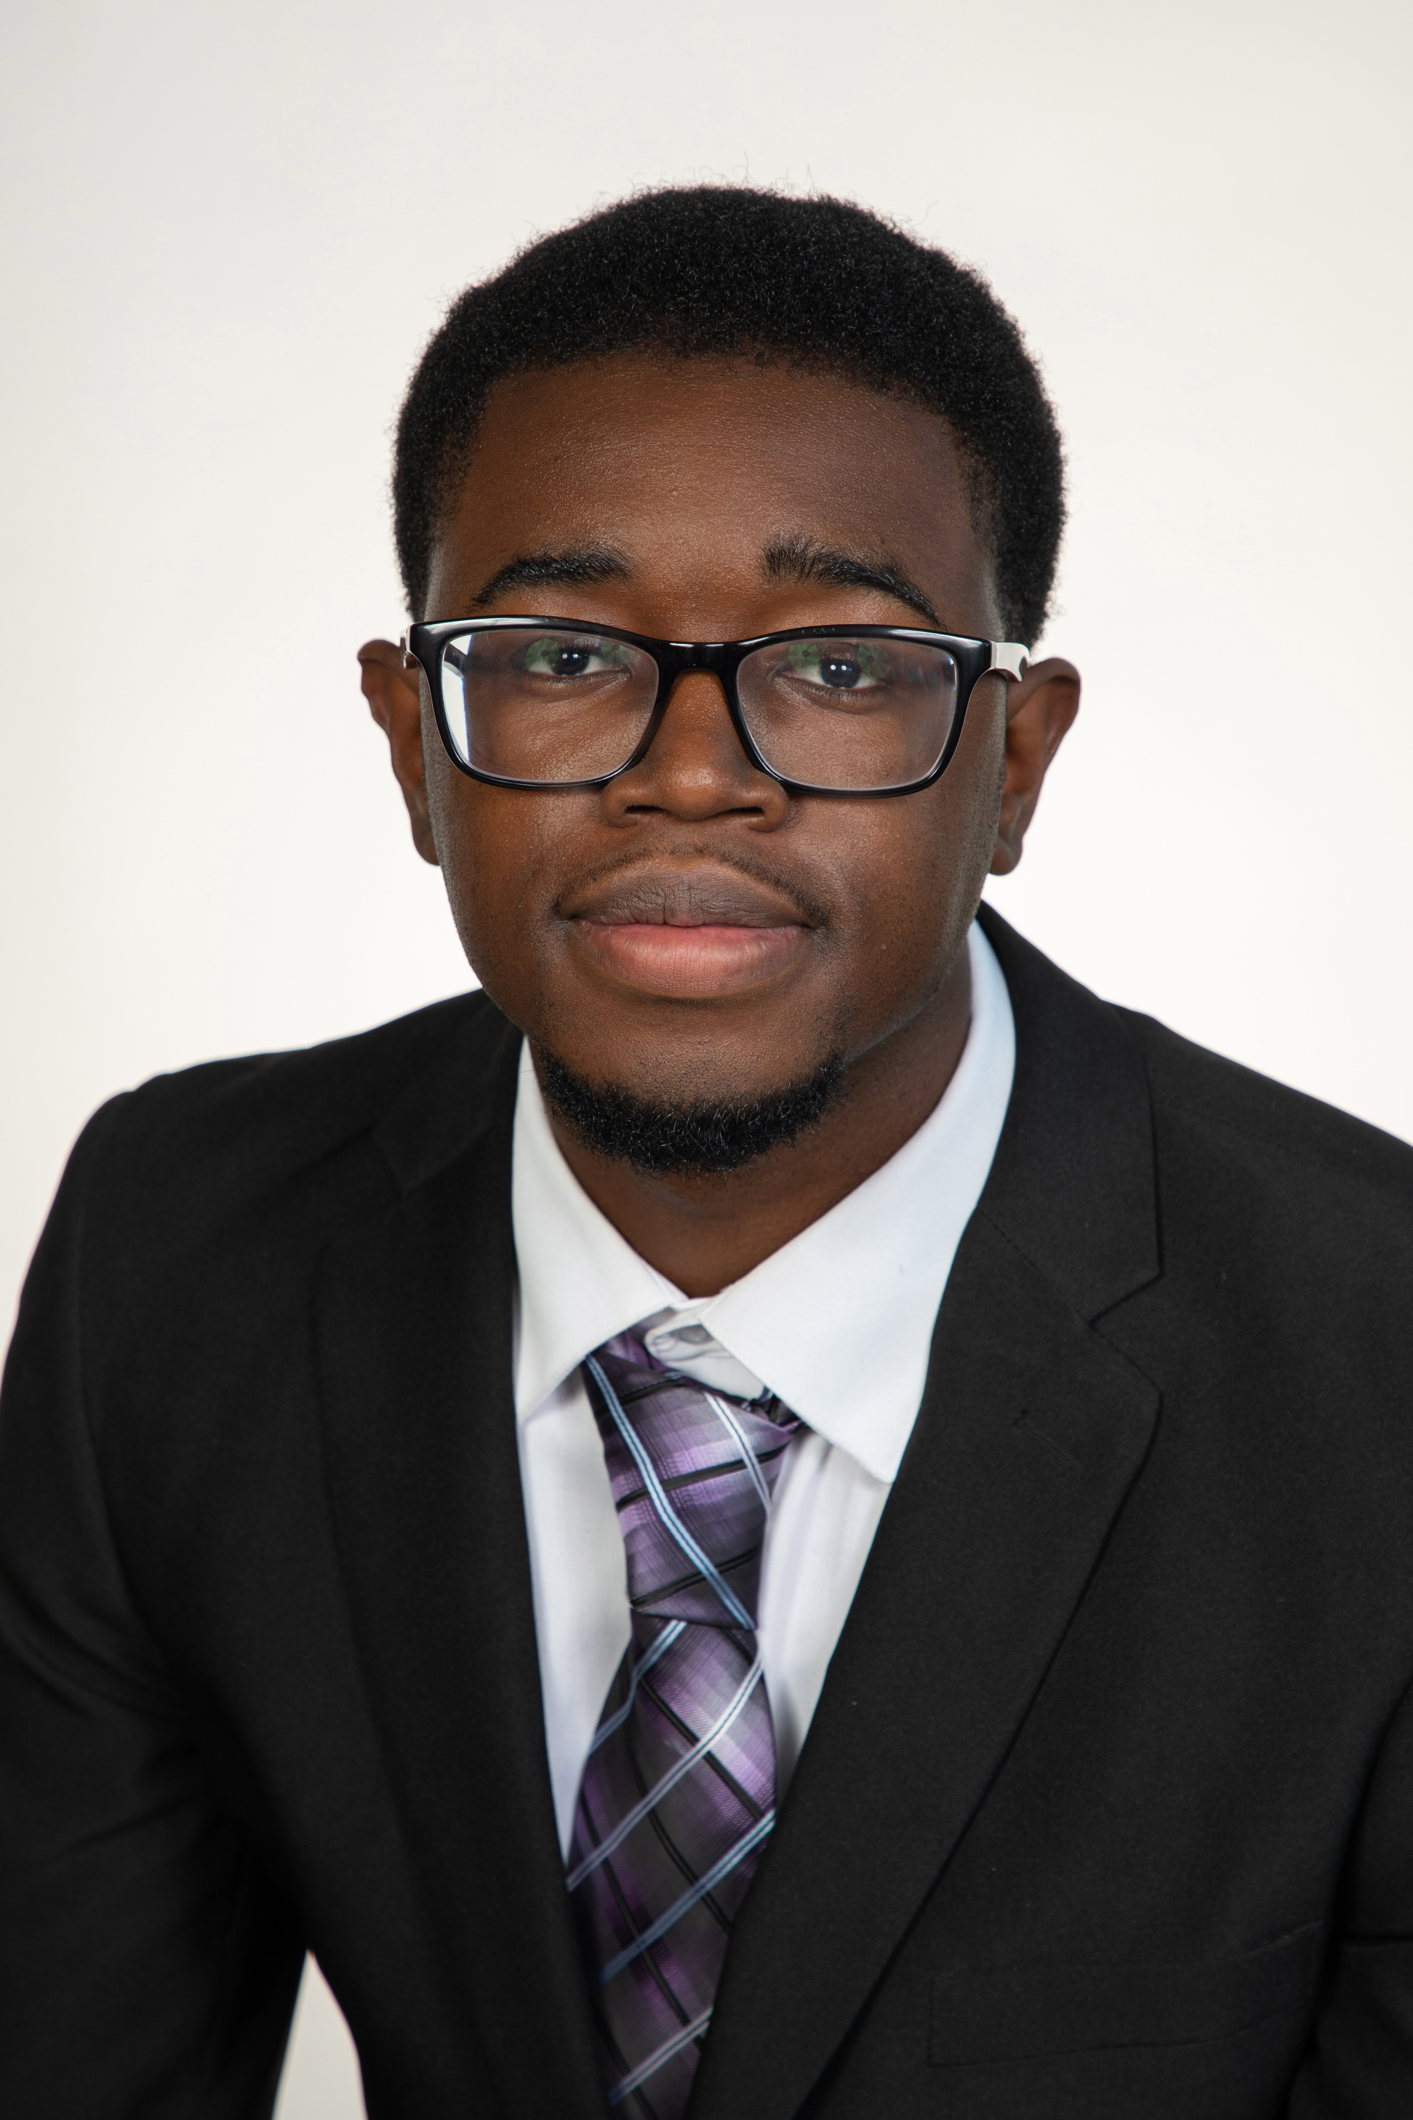
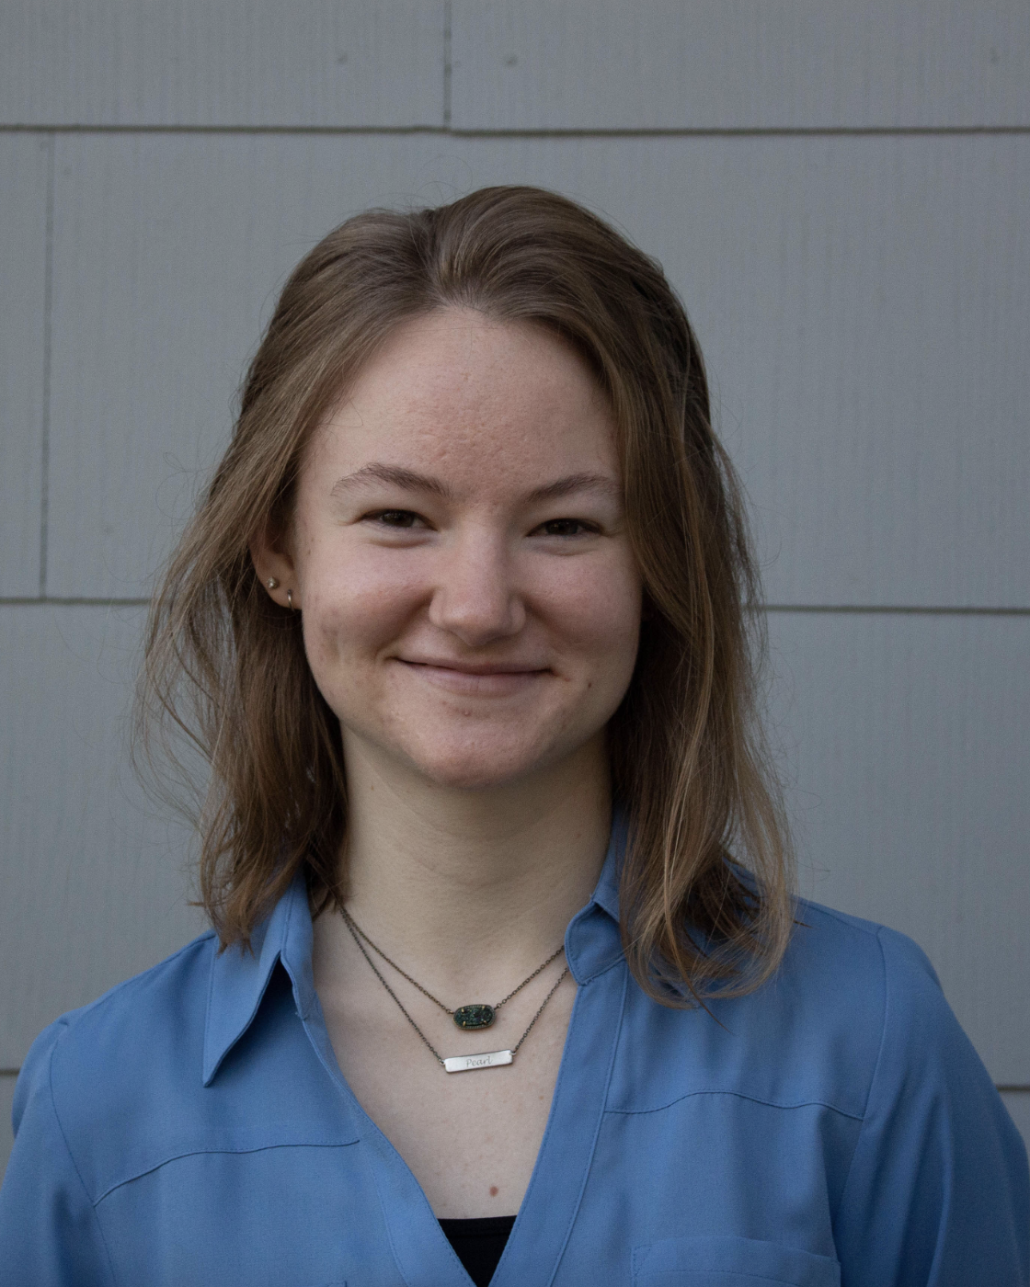
Kencin Autry
Team Introductions
Kencin Autry
Research
Development
Engineer
Matthew Kennedy
Structural Design
And Materials
Engineer
Timothy Norman
Structural Design
And Manufacturing
Engineer
Lapadre Proctor
Test and Quality
Control Engineer
Lily Thompson
Computational
Fluids Engineer
2

Slide 3
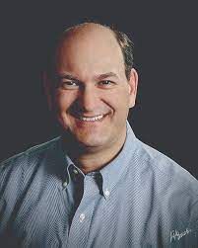
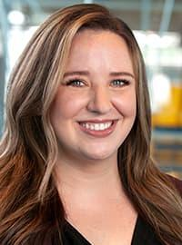
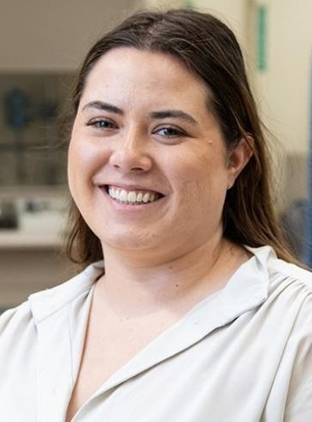
Kencin Autry
Sponsor and Advisors
Sponsor
Gary Mishkin
CEO Apollo Renal Therapeutics
DBA Artemis Plastics
Academic Advisor
Dr. Rebekah Sweat
Assistant Professor
Academic Advisor
Aspen Reyes Graduate Research Assistant

Slide 4
Kencin Autry
Objective
The objective of this project is to reduce the quantity of waste-water in the dialysis process by efficiently purifying standardized filtered water and spent dialysate to ultra-pure water.
Notes:
l

Slide 5
What is Dialysate?
Kencin Autry

Slide 6
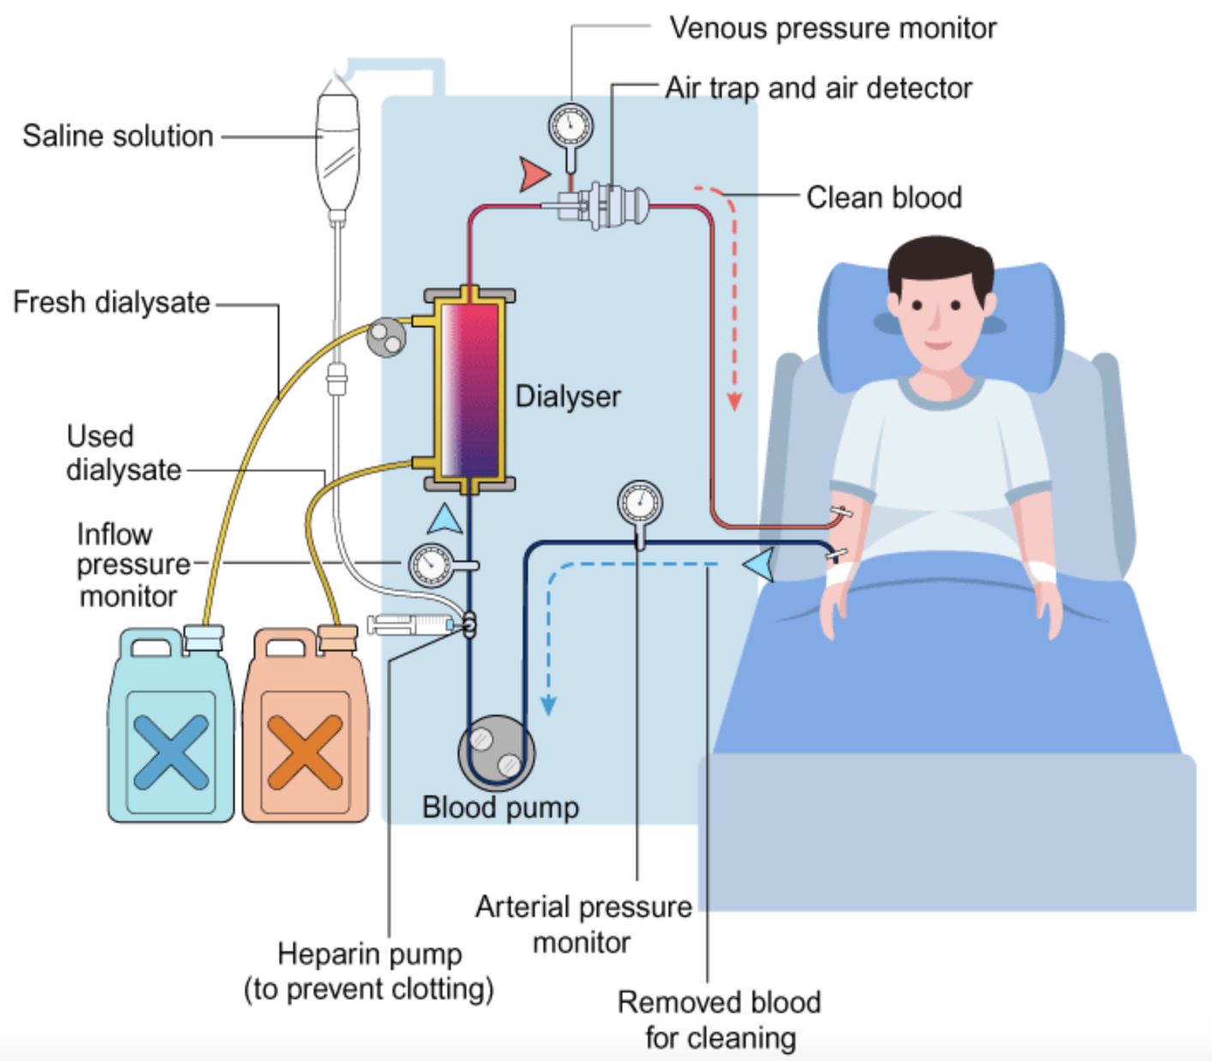
Kencin Autry
Project Background
Hemodialysis is a therapy treatment for patients with end-stage kidney disease (ESKD).
6

Slide 7
Kencin Autry
Hemodialysis Process
7

Slide 8
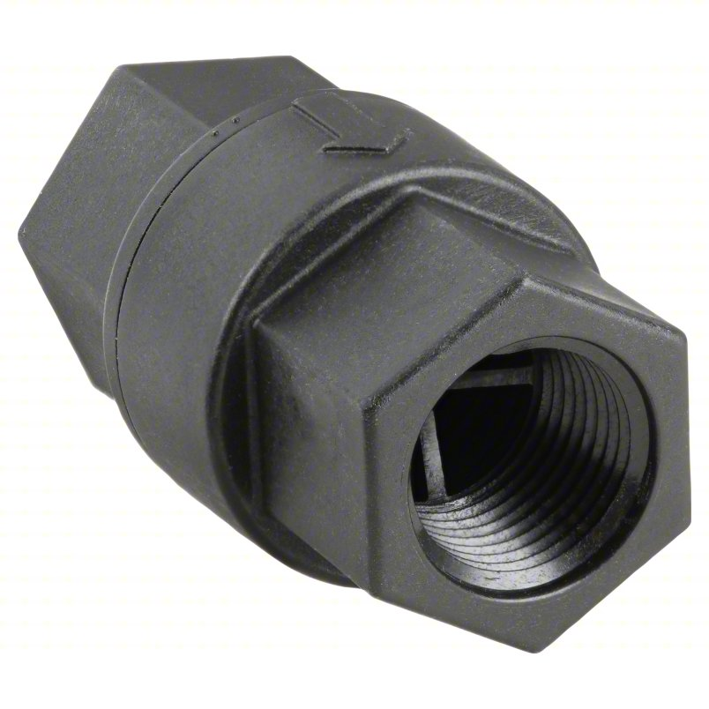
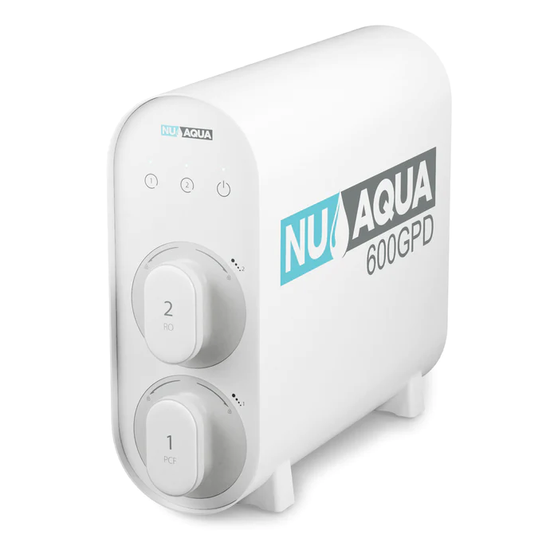
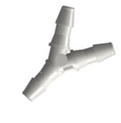
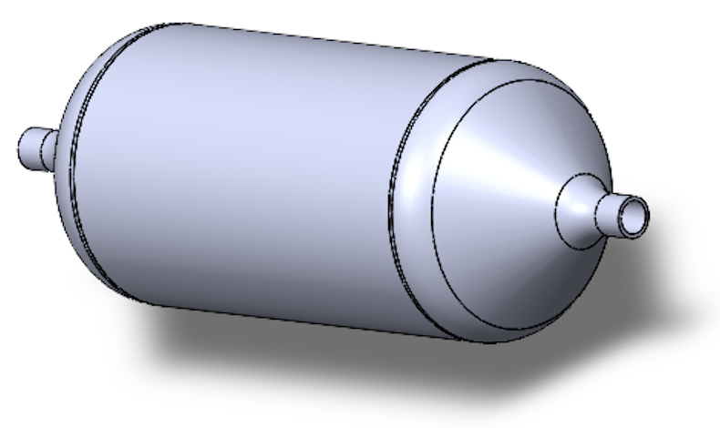
Kencin Autry
Our System
Water Quality Testing
Primary Pump
Filtered
Water Runoff
Check Valves
Water Quality Testing
RO System
Spent Dialysate Runoff
CNT Filter
8

Slide 9
Lapadre Proctor
Key Goals
Enhancing efficiency and preventing the potential hazards of large water filtration systems
Recycling spent dialysate back into ultra-pure water
Filtered water will meet ultra-pure water standards
9

Slide 10
Lapadre Proctor
Customer Needs
Design requires relatively low maintenance and will last approximately 1 year
Design should fit into a space no larger than 10 in x 12 in x 5 in
Hansen connector and Barbed Port input
Handle a maximum flow rate of 1000 mL per minute
Produce Ultra-Pure water
10
10
10

Slide 11
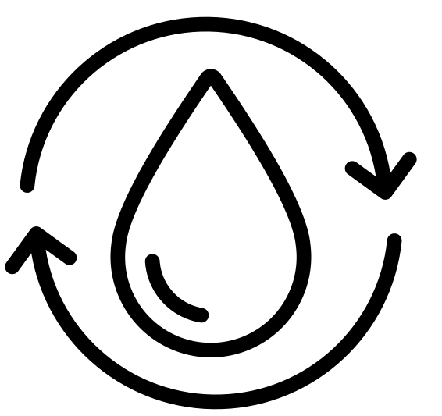
Critical Targets and Metrics
Lapadre Proctor
Purify Water
Recycle Spent Dialysate
Ergonomic Compatibility
Raise and Lower Flow Rate
< 0.001 ppm TDS
75% Efficiency
10 x 12 x 5 in
100 – 1000 mL per minute

Slide 12
Concept Generation
Lapadre Proctor
Secondary Dialyzer
Lego Sorter
Chemical Coagulant
Nanofiltration and Reverse Osmosis
Nanofiltration

Slide 13
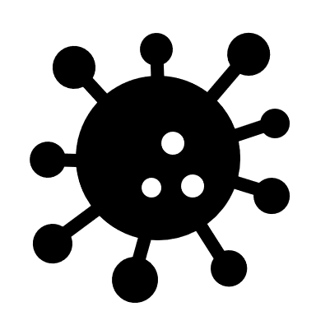
High-Fidelity
Lapadre Proctor
Carbon Nanotube (CNT) and Ultrasonics
Forward Osmosis
Gaseous Ozone
Ozone Generator

Slide 14
Final Concept
Lapadre Proctor
Carbon Nanotubes (CNTs) and Ultrasonics
Reverse Osmosis (RO)
Notes:
* NASA

Slide 15
Lapadre Proctor
Water Quality Testing
Primary Pump
Filtered
Water Runoff
Check Valves
RO System
Water Quality Testing
Spent Dialysate Runoff
CNT Filter
Notes:
Needs to be cleaned up if we do use it

Slide 16
RO System
Lapadre Proctor
3 Stage Filtering
2-in-1 Polypropylene Sediment and Carbon Block Filters
Specifications
Incoming water must be between 14.5 and 58 psi
Reverse Osmosis Membrane
Filters at 1590 mL per minute
Notes:
Should we go into the individual components?
Claims to remove 99% of contaminants for drinking water standards
Filters last 12 – 24 months
Incoming water must be between 14.5 and 58 psi
Filters at 1590 mL per minute
Will have to adapt to two water inputs

Slide 17
Lily Thompson
Water Quality Testing
Primary Pump
Filtered
Water Runoff
Check Valves
RO System
Water Quality Testing
Spent Dialysate Runoff
CNT Filter

Slide 18
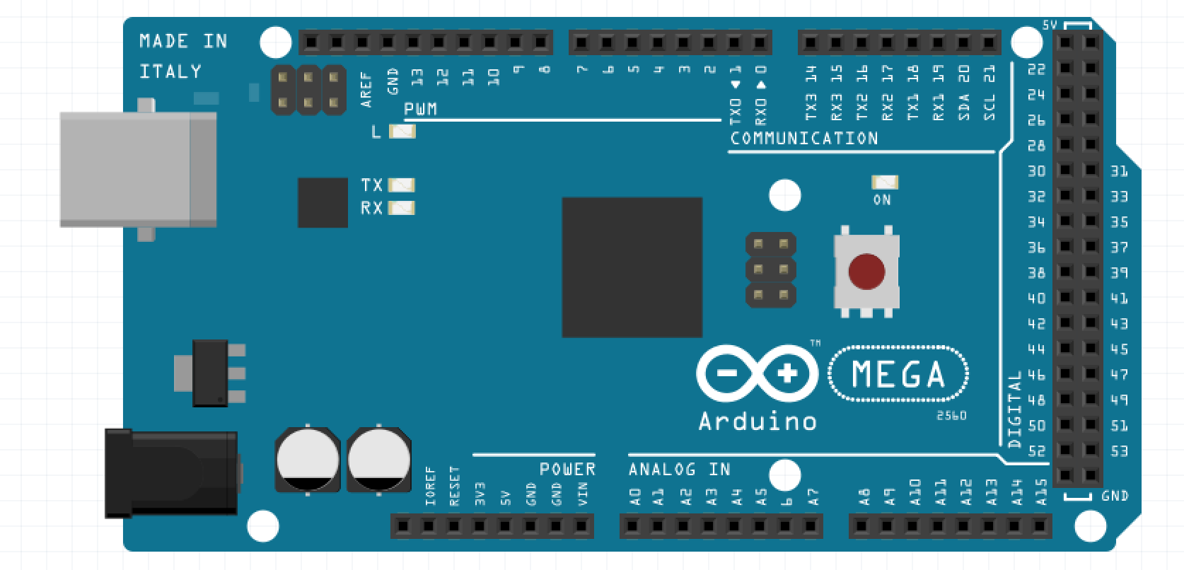
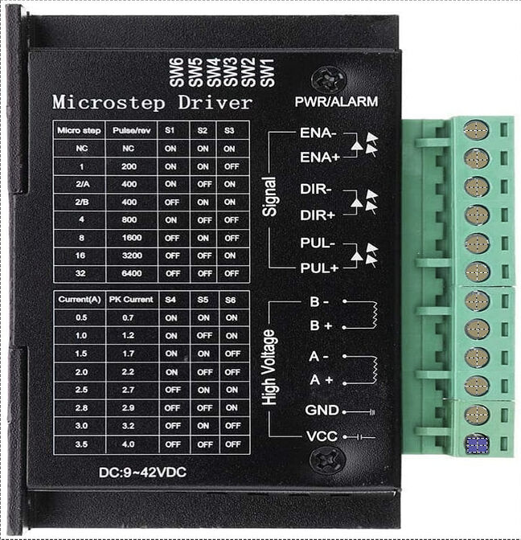
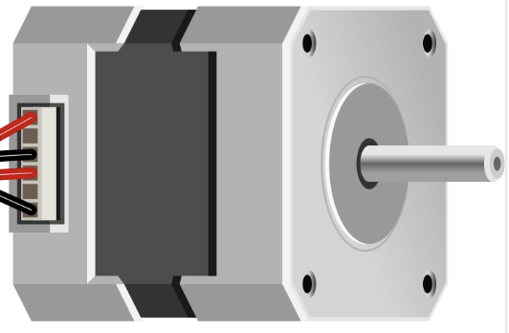
Primary Pump
Lily Thompson
Connections
Arduino Microcontroller Mega
Specifications
Maximum flow rate of 1600mL per minute
TB6600 Motor Driver
12 V Power Supply
Stepper Motor
Peristaltic
12 V Supply
Notes:
Should we go into the individual components?
24V Stepper motor
Silicone tube,7.9mm ID × 11.1mm OD
Flow Rate of 1600ml/min
Ambient temperature 0-40℃
Relative humidity <80%
Reduction ratio 1:20

Slide 19
Timothy Norman
Water Quality Testing
Primary Pump
Filtered
Water Runoff
Check Valves
RO System
Water Quality Testing
Spent Dialysate Runoff
CNT Filter

Slide 20
Carbon Nanotube (CNT) Housing
Timothy Norman
Materials
Inside Layer: 3D Printed with PLA
Configuration
Well-rounded with angle of 45 degrees
Cylindrical
Middle Layer: Foam for ultrasonics
Outside Layer: PLA

Slide 21
Ultrasonics
Timothy Norman

Slide 22
Prevention
Lily Thompson
Notes:
Ensuring the spent dialysate can’t leak around the CNT when placed into the housing.
FSU red flagging the Urea

Slide 23
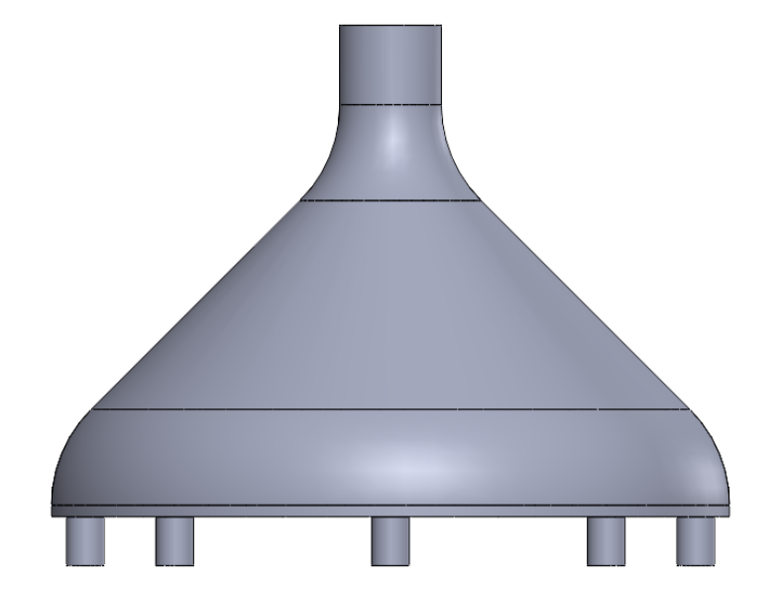
Configuration
Lily Thompson
$$diameter=3/8 inch$$
$$θ$$
$$θ=45°$$
$$diameter=2 inches$$
Notes:
Put dimensions on here (For this slide, How about inside of showing the angles on the exterior of the shell, we take a cross section of the lid and show the inside of it) - Matt

Slide 24
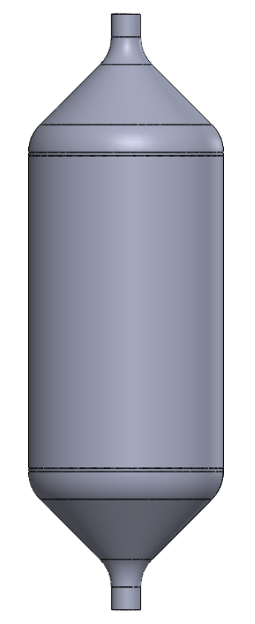
Fluid Computations
Lily Thompson
Key
$$A=Area$$
$$V=Velocity$$
$$P=Pressure$$
$$ρ=Density$$
$$P_{1}$$
$$V_{1}$$
Mass Conservation
Control Volume
?
$$A_{1}V_{1}=A_{2}V_{2}$$
?
$$P_{1}+\frac{1}{2}ρV_{1}^{2}=P_{2}+\frac{1}{2}ρV_{2}^{2}$$
$$P_{2}$$
$$V_{2}$$
$$P_{1}>P_{2}$$
Semi-permeable Membrane
$$V_{1}>V_{2}$$
Notes:
Put dimensions on here

Slide 25
Take Away
Lily Thompson
Sudden Expansion:
Too many unknowns in calculations
Future experiments can determine pressure difference, output velocity, and ideal ratio of diameters
Gradual expansion and contraction:
Gradual expansion and contraction

Slide 26
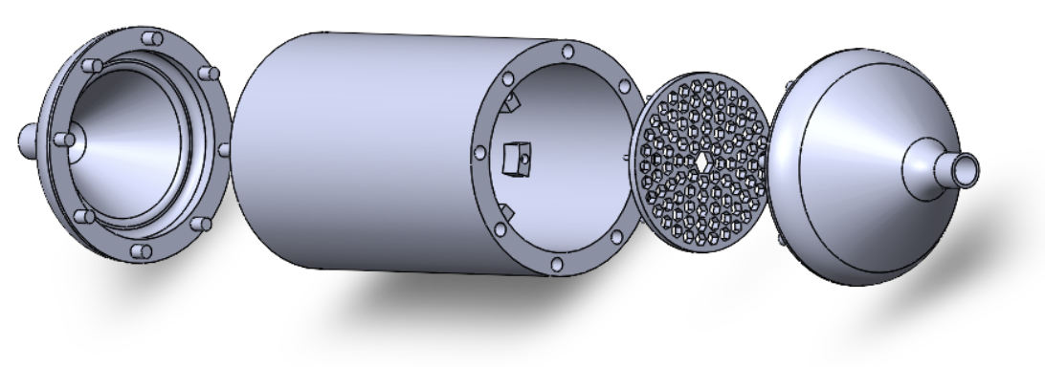
Inside Housing
Timothy Norman
Notes:
I honesty do think we should color code it so we can talk about the individual parts. There’s no way to talk about each part without something differentiating them like color.

Slide 27
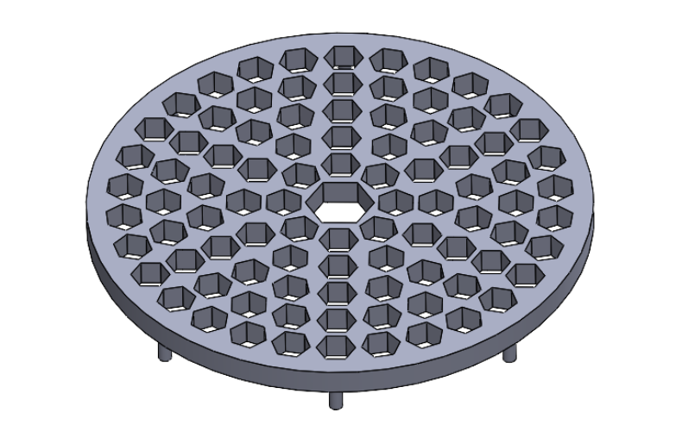
CNT Filter Placement
Timothy Norman

Slide 28
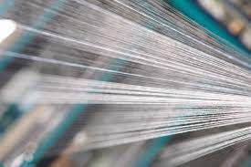
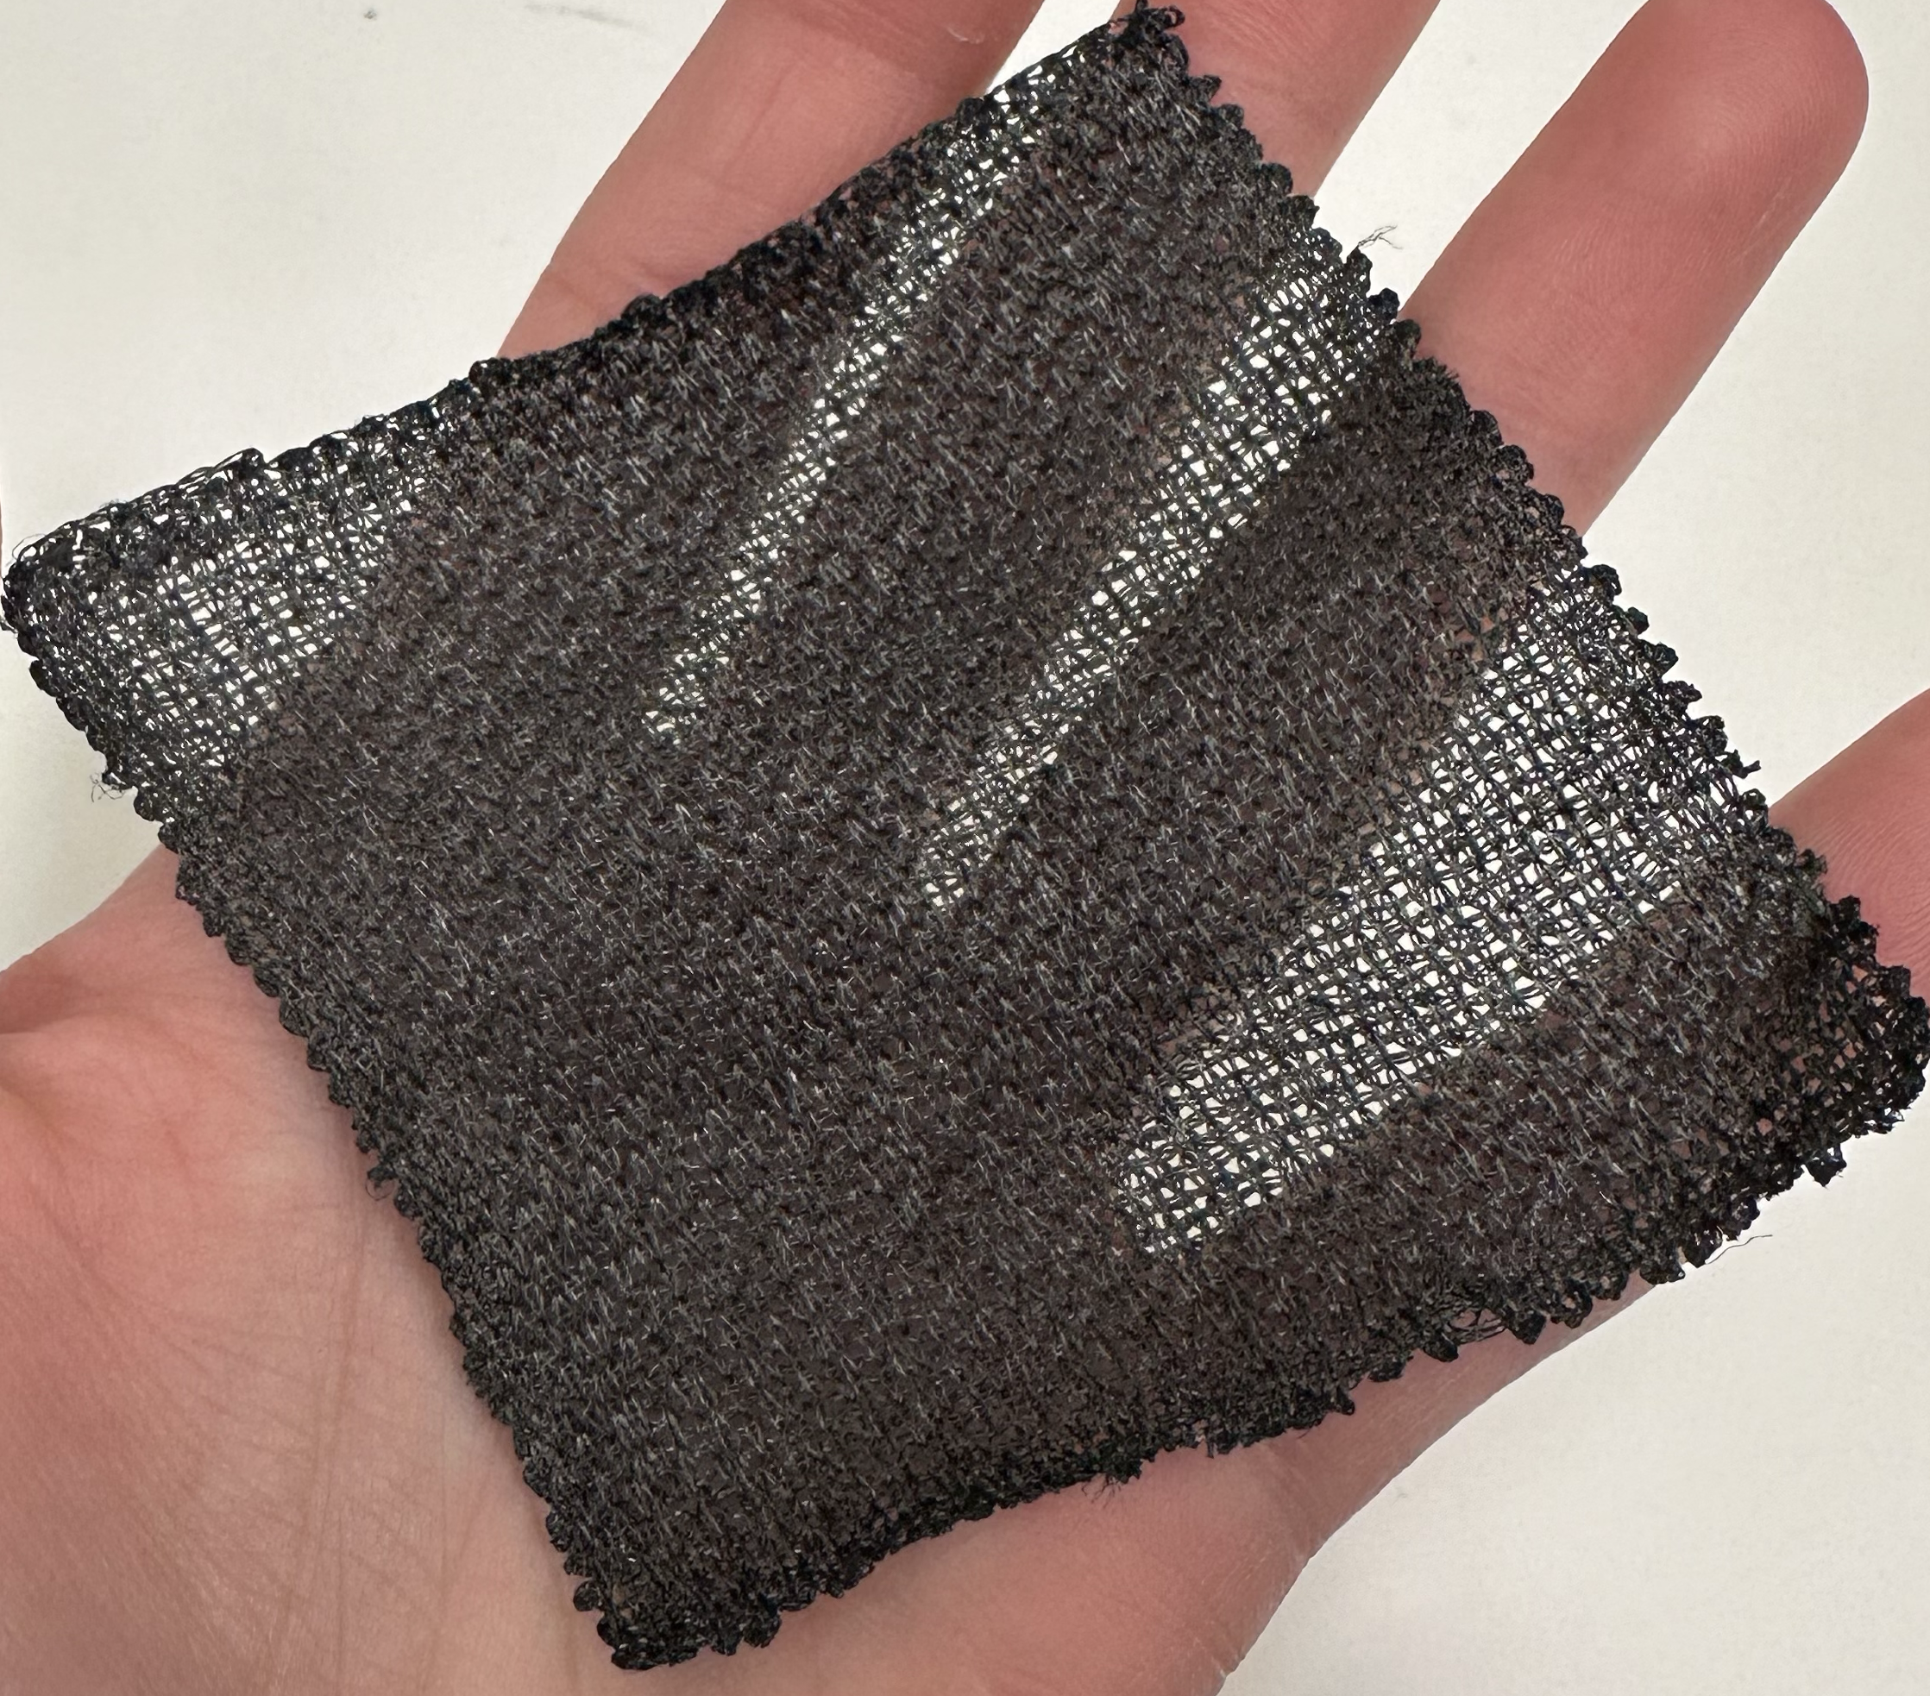
Carbon Nanotubes (CNTs)
Kencin Autry
Tubes made of carbon that have incredible tensile strength and thermal conductivity due to bonds between carbon atoms
Multi-Walled Carbon Nanotubes (MWCNTs) are nested nanotubes that provide unique diameter variability
Can be used in the form of yarns, fabrics, bucky paper and resin infused bucky paper

Slide 29
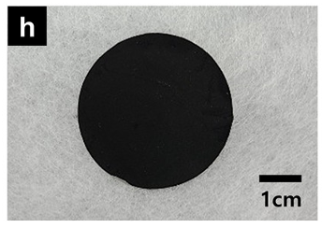
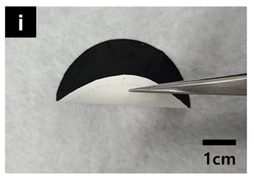
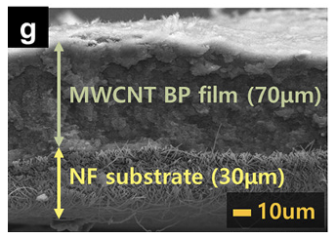
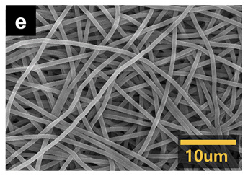
Bucky Paper CNT Film
Kencin Autry
Multi-Walled Carbon Nanotube (MWCNT) Film
Average bucky paper thickness of about 0.06mm
Randomized dispersion with individual strands entangling
Notes:
Multi-Walled Carbon Nanotube (MWCNT) Film
Bucky paper thickness of about 0.06mm
Randomized dispersion with individual strands entangling

Slide 30
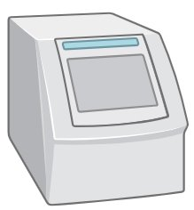
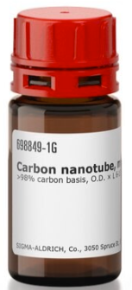
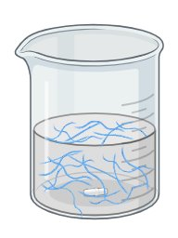
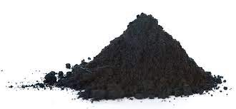
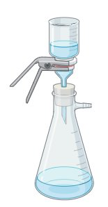
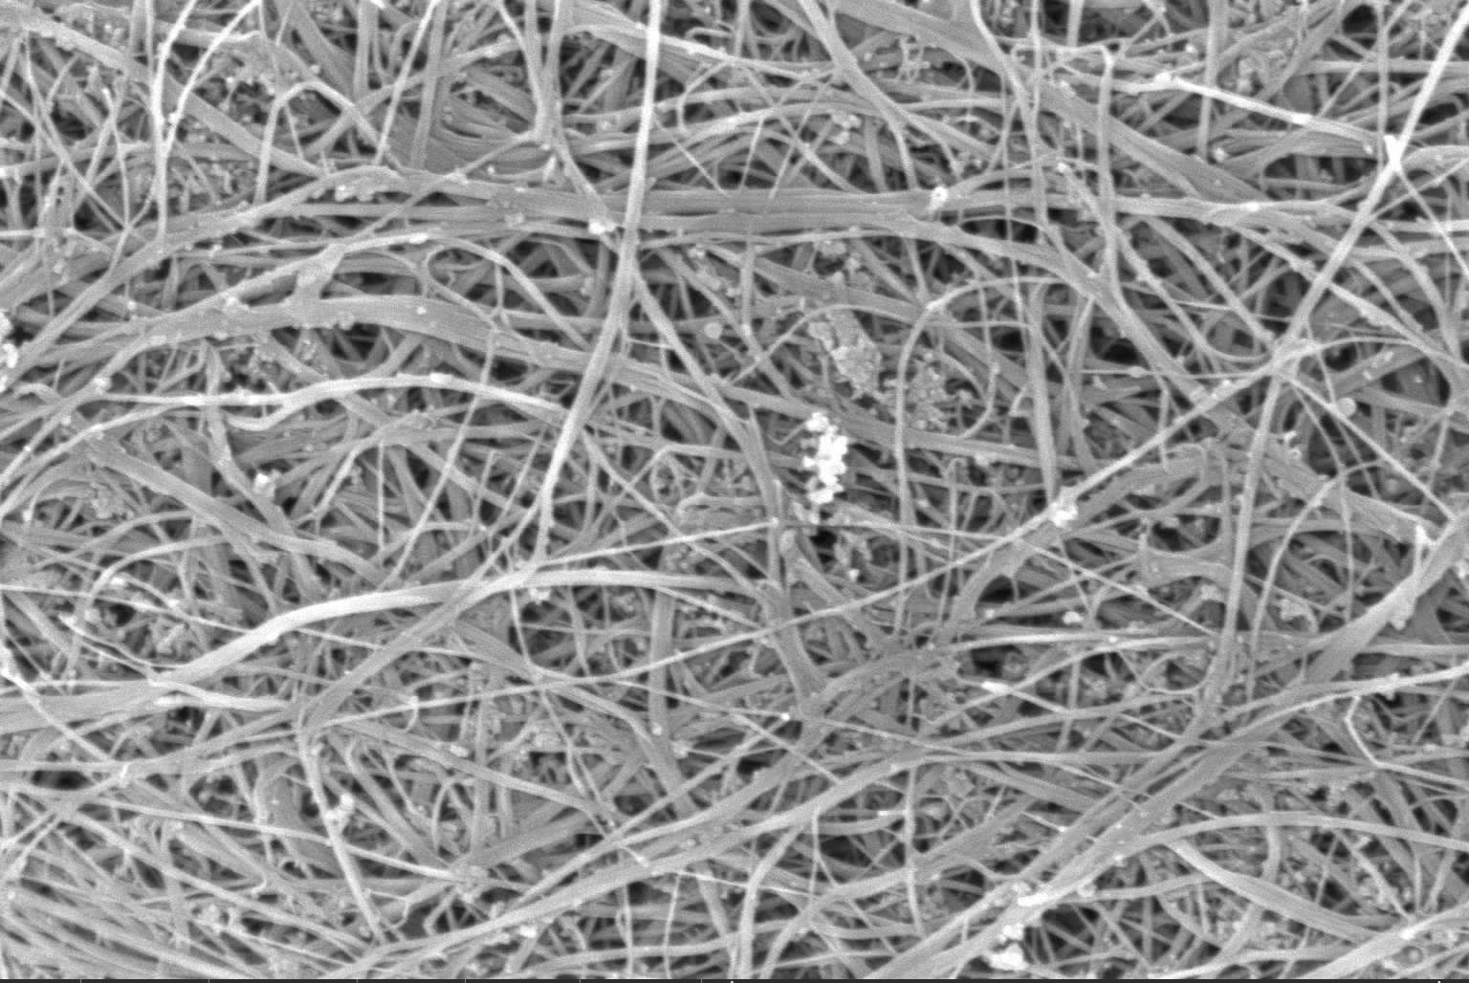
“Bucky paper” Production
Timothy Norman
Sonicator
Powdered CNTs
Final Bucky Paper
Vacuum Aided Filtration

Slide 31
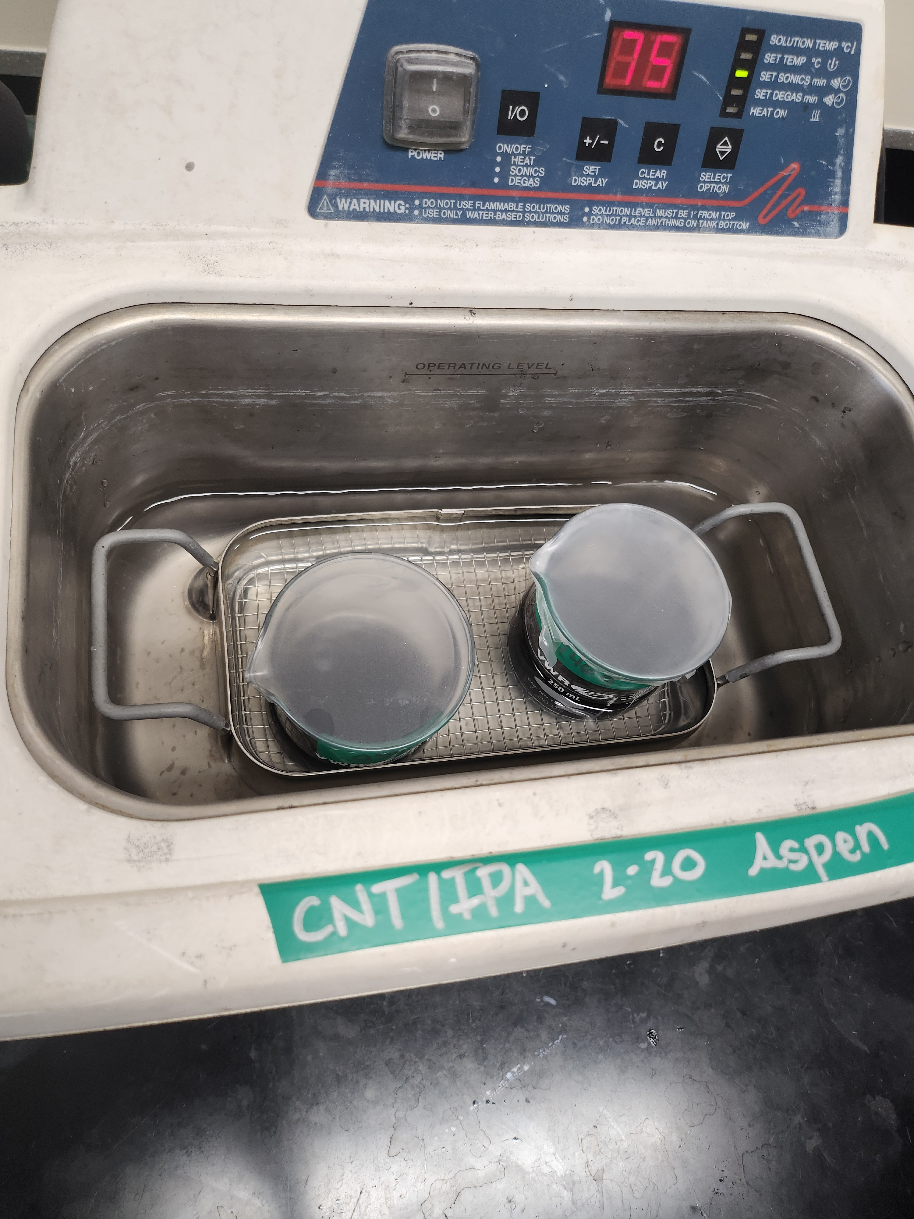
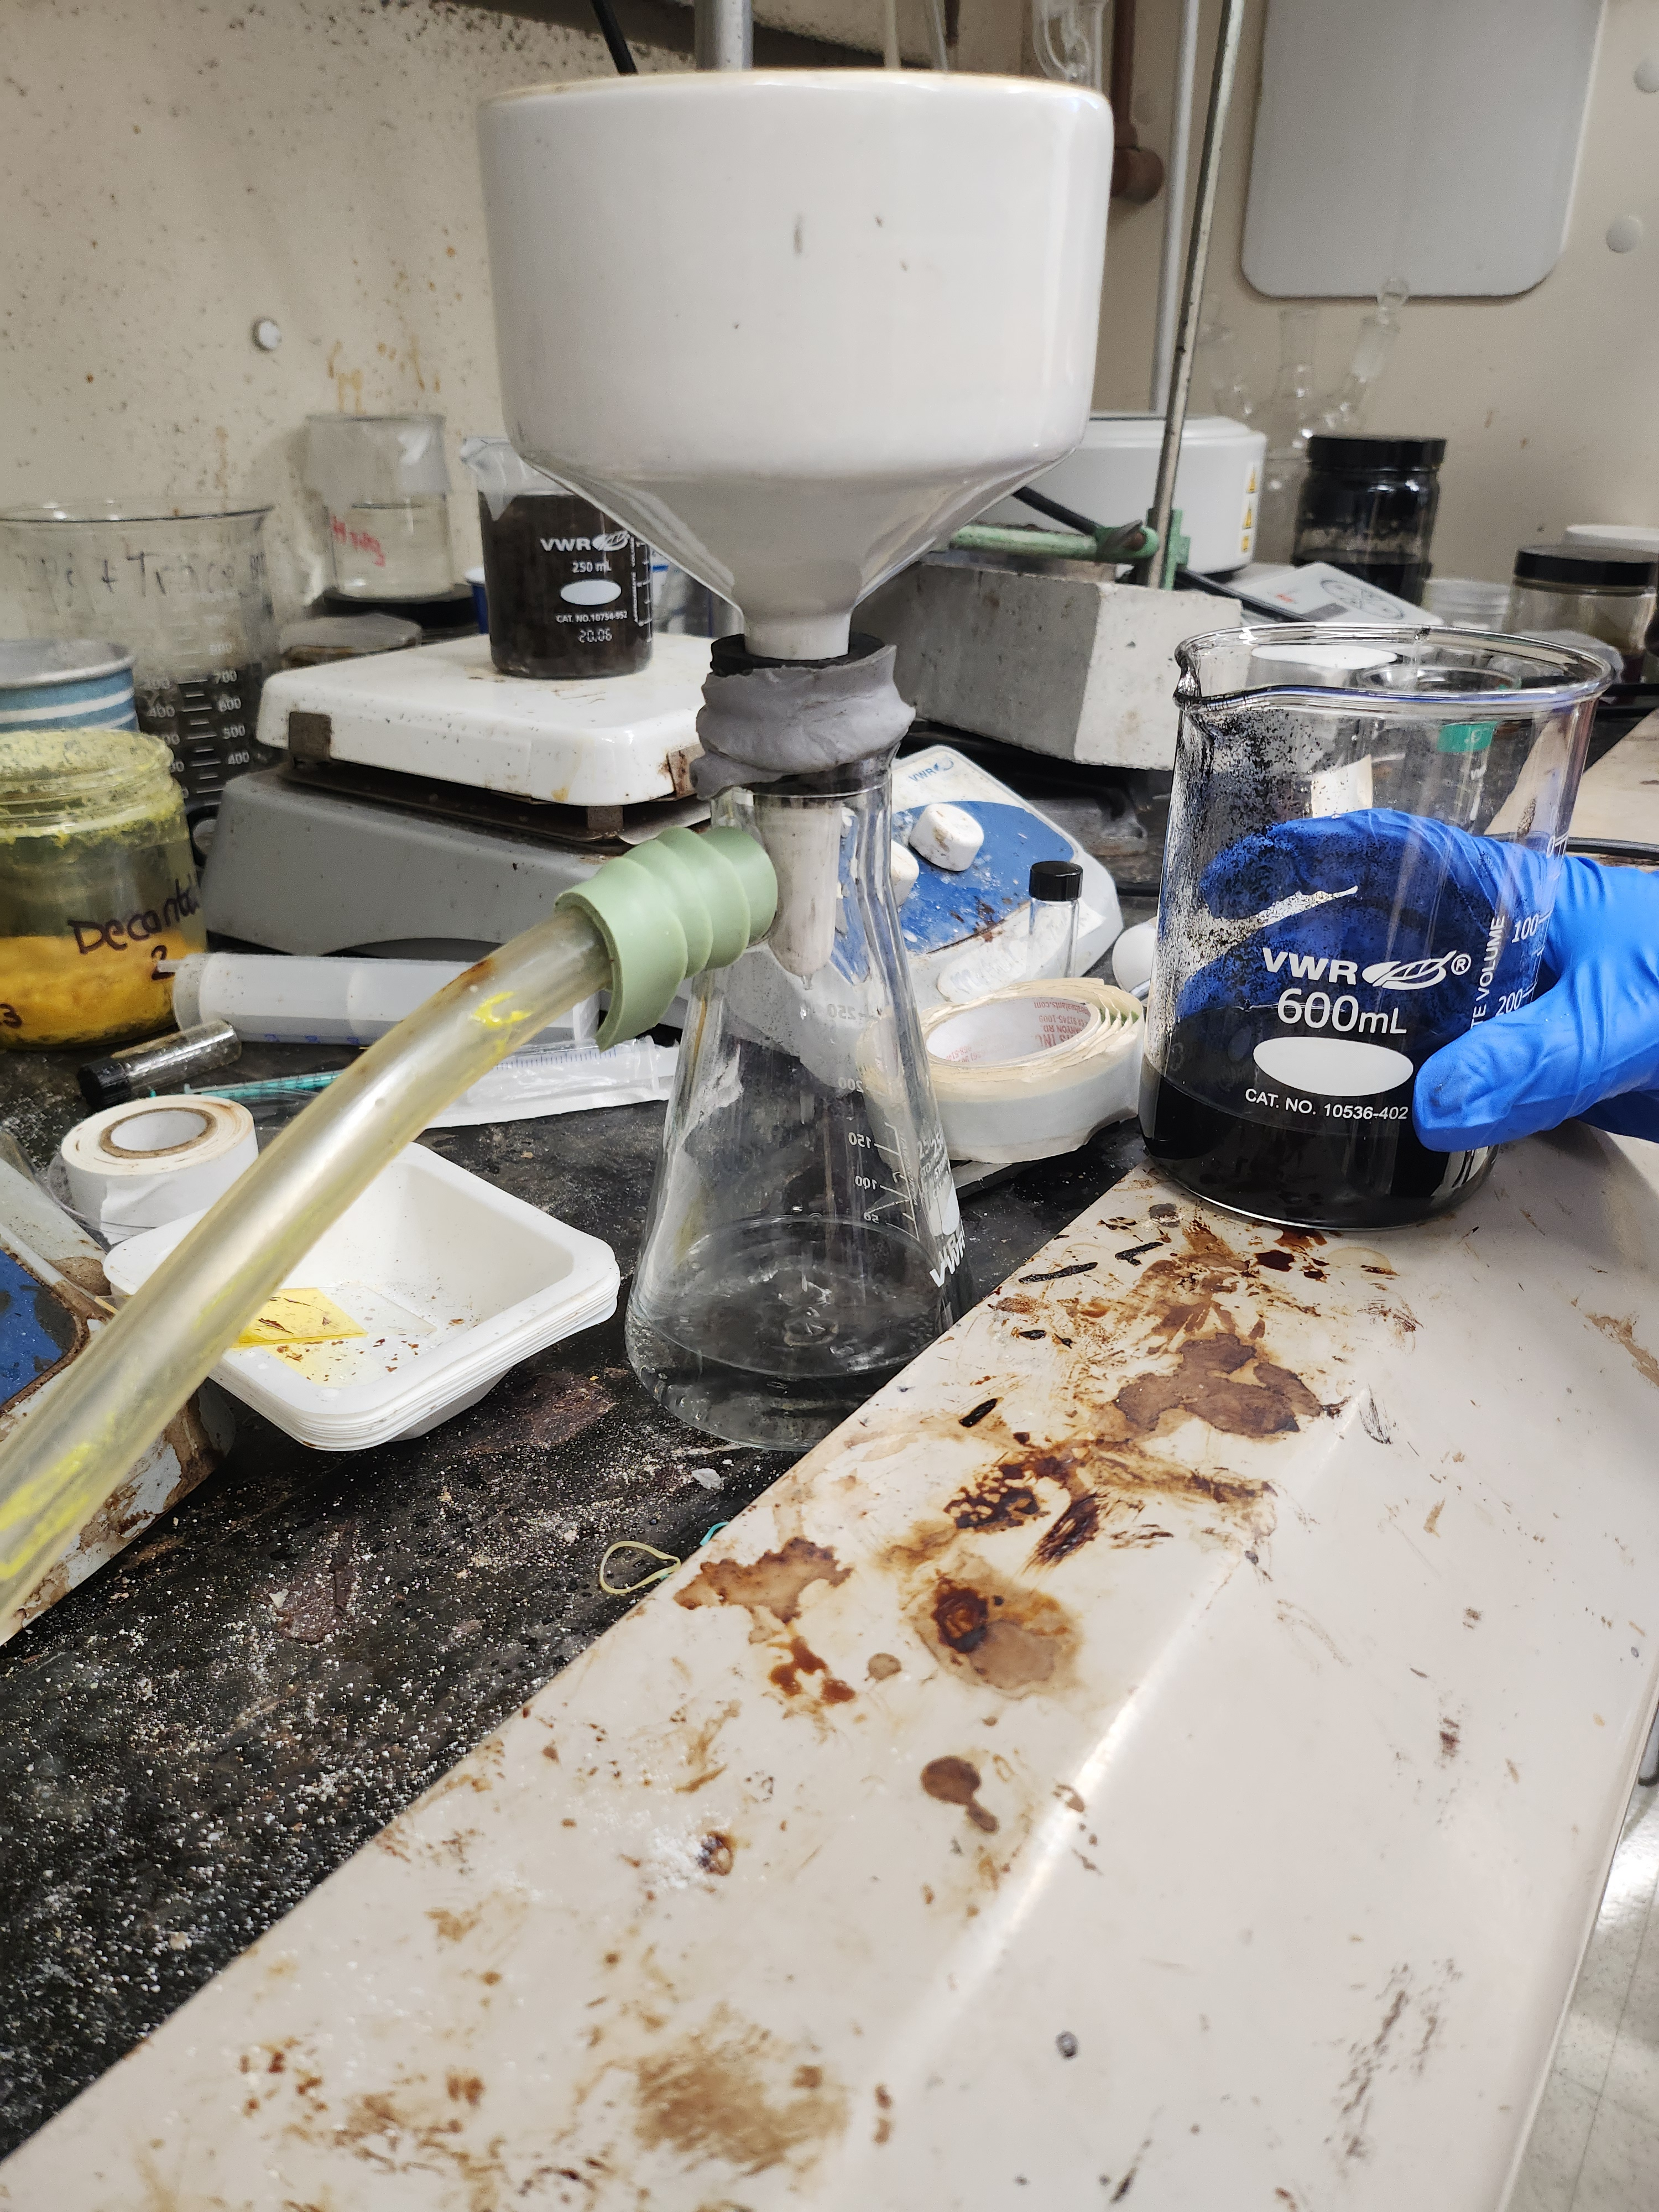
Bucky Paper Production
Timothy Norman
Sonication
Vacuum Filtration
Drying CNT film

Slide 32
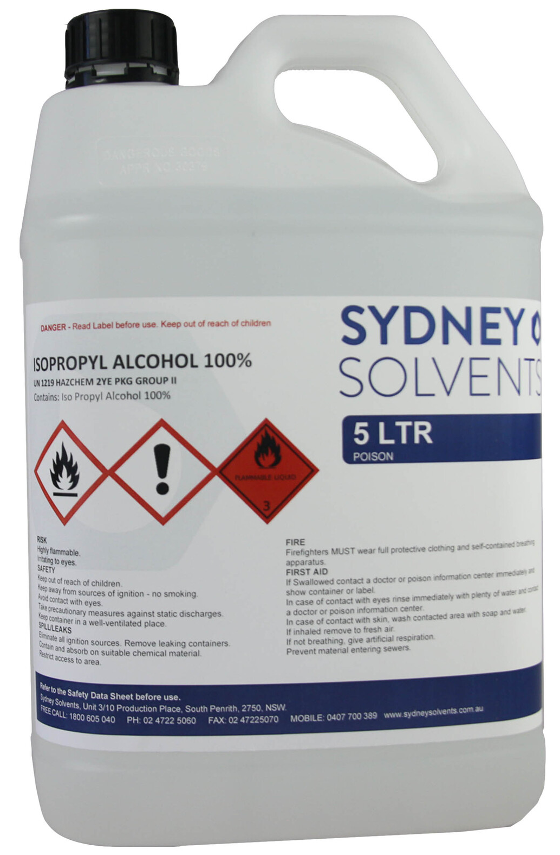
First Bucky Paper Production
Timothy Norman
Materials
Process Specifications
200 grams Isopropyl Alcohol
Sonicated for 3 hours and 15 minutes
0.125 grams of MWCNTs
Vacuum filtered twice
Dried compressed in metal plates and Teflon paper
Notes:
200 grams Isopropyl Alcohol
0.125 grams of powdered CNTs
Sonicated for a total of 3 hours and 15 minutes
Vacuum filtered twice
Vacuum aided drying overnight
Produced a sheet of thickness 0.03 millimeters
Dried with metal plates and Teflon paper
Also will include second round on same slide or on second

Slide 33
Second Bucky Paper Production
Timothy Norman
Materials
Process Specifications
200 grams Isopropyl Alcohol
Sonicated for 6 hours and magnetically mixed overnight
0.250 grams of MWCNTs
Vacuum filtered twice
Dried compressed in metal plates and Teflon paper
Notes:
200 grams Isopropyl Alcohol
0.125 grams of powdered CNTs
Sonicated for a total of 3 hours and 15 minutes
Vacuum filtered twice
Vacuum aided drying overnight
Produced a sheet of thickness 0.03 millimeters
Dried with metal plates and Teflon paper
Also will include second round on same slide or on second

Slide 34
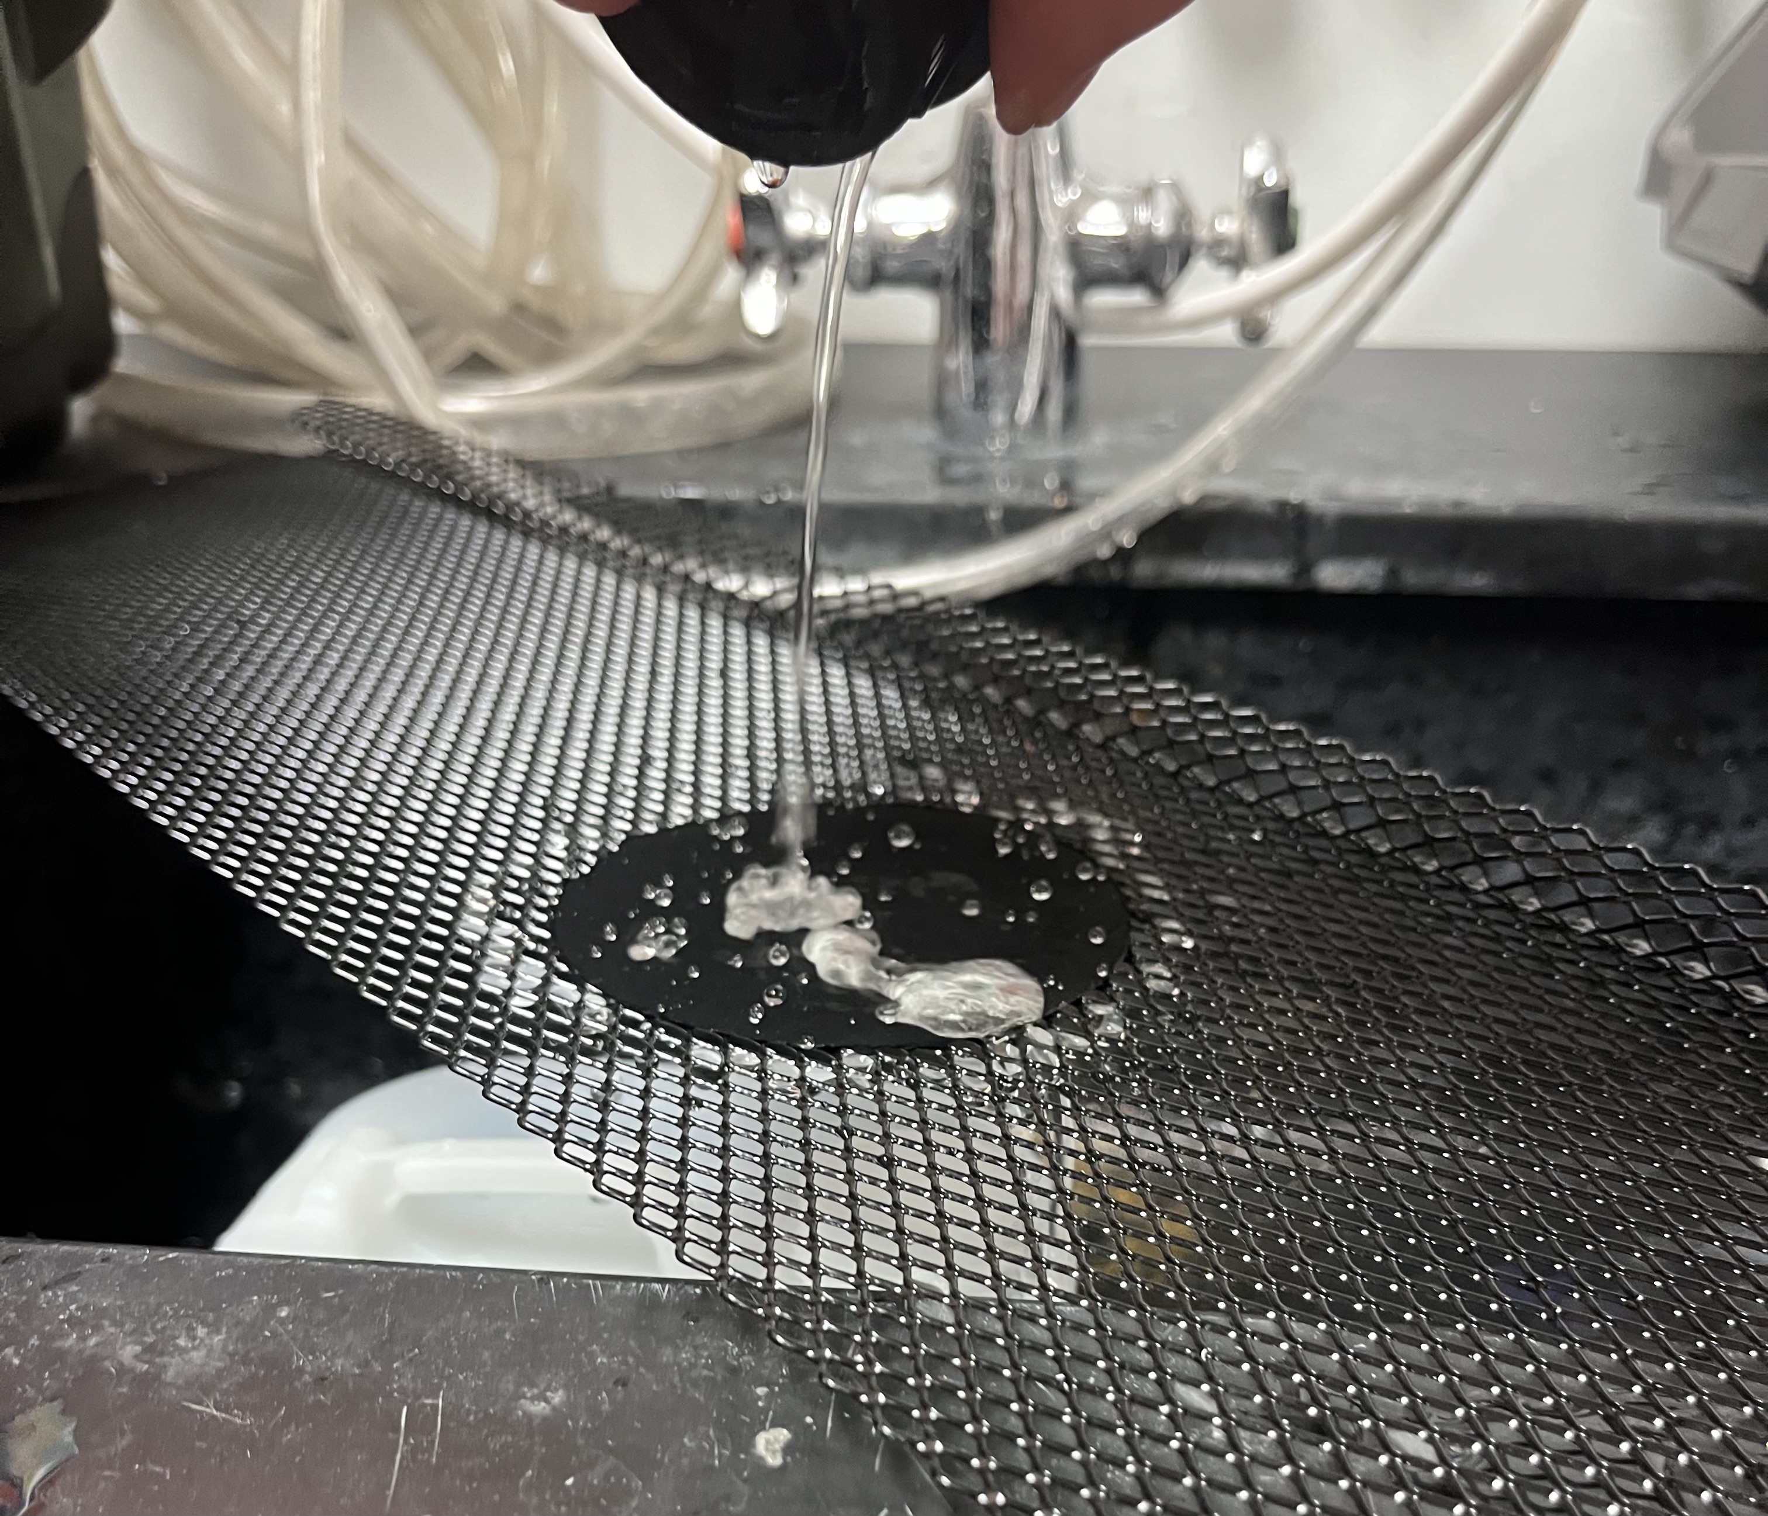
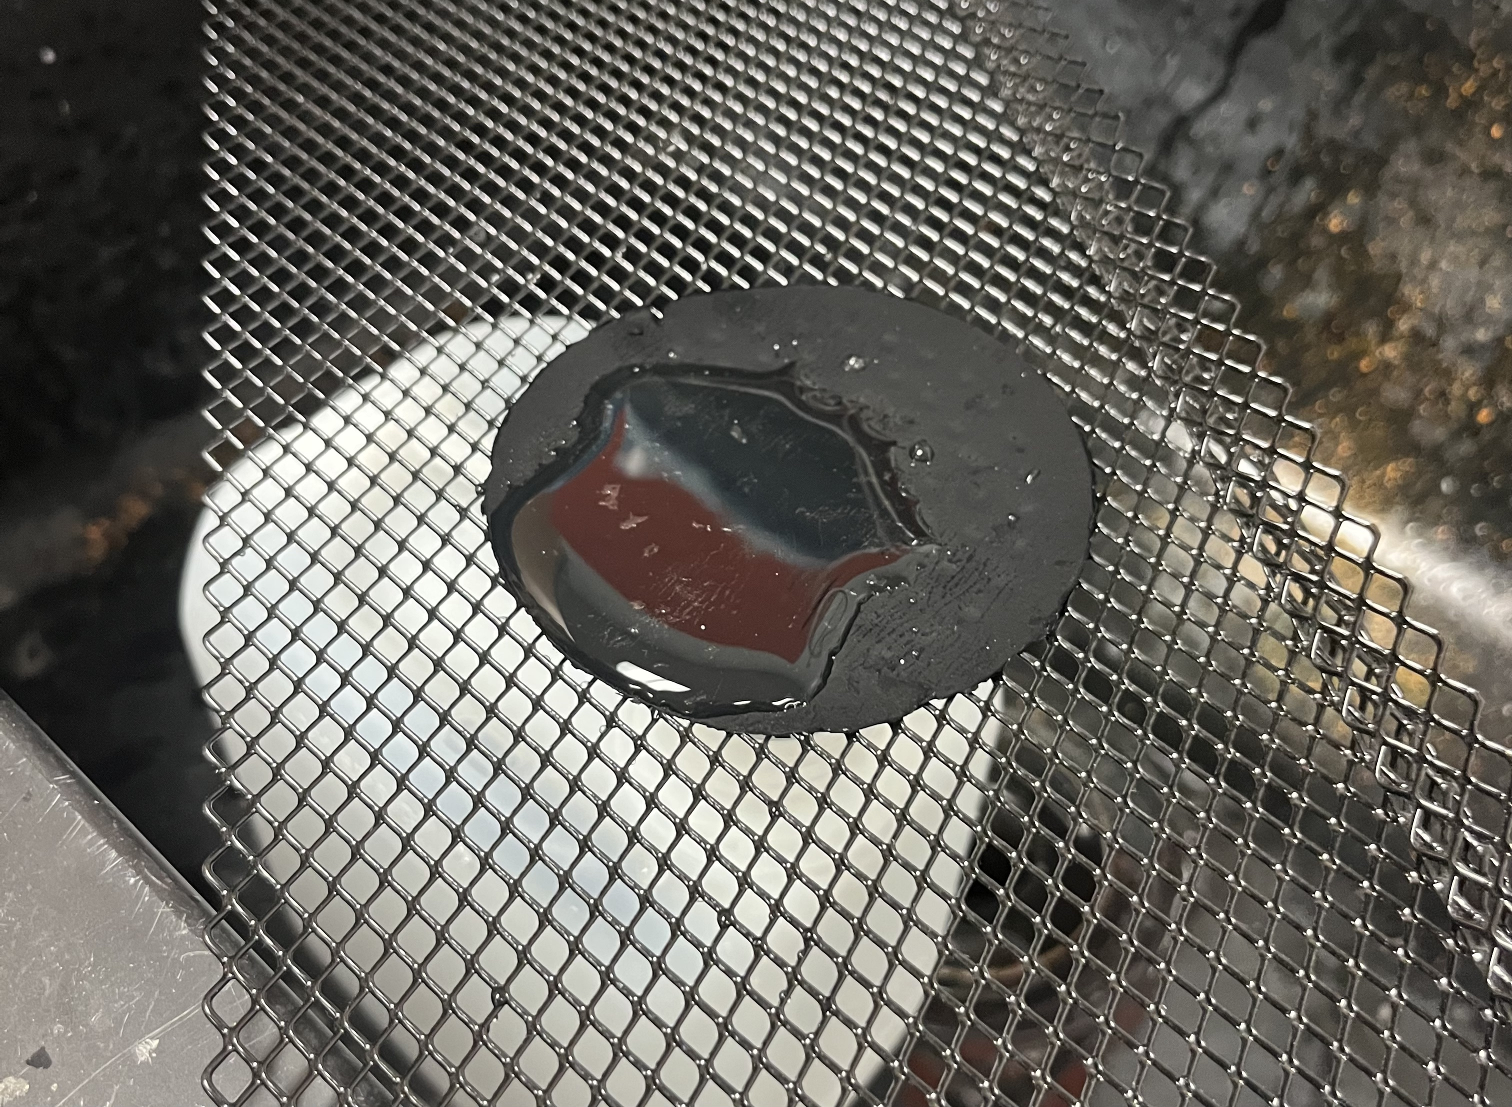
Results
Lapadre Proctor
Produced 3 sheets of CNTs all with equal thickness
Due to nature of entangled CNTs
CNTs were hydrophobic
No filtration capabilities
Notes:
Produced 3 sheets of CNTs all with equal thickness
The plan was to have three grates inside the housing and comparatively test better filtration with placing one by one inside
But..
Explain why we thought it failed
CNTs were hydrophobic
No filtration capabilities
Nature of randomly dispersed CNTs

Slide 35
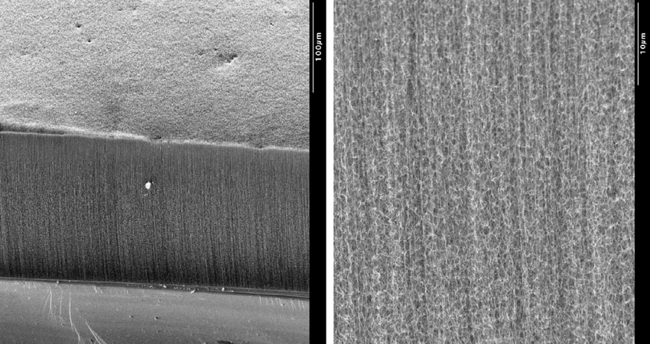
Response
Matthew Kennedy
Notes:
Ordered a vertically aligned sheet of CNTs
Vertically aligned CNTs are a proven filtration method
Awaiting shipment

Slide 36
Results
Lapadre Proctor
Used a pipette to drip water onto single film
Also hydrophobic so no filtration capabilities
Sheet too thin for desired flowrate
Due to bonds between the carbon atoms
Notes:
CNT matrices are whats used in NASA prototype so might need to look at other forms of containing CNTs

Slide 37
Testing Methods
Matthew Kennedy
TDS : 0 – 19.99 ppt
Conductivity
Water Temp
Filtered Water
pH
Notes:
https://www.grainger.com/product/EXTECH-Conductivity-Meter-38W993

Slide 38
Testing Methods
Matthew Kennedy
Filtered Water
Notes:
Urea raises the pH and

Slide 39
Further Testing Methods
Matthew Kennedy
Total Organic Carbons
Resistivity
Filtered Water
Ammonia
Notes:
Total Organic Carbons
Reactivity
Endotoxins
Chemicals
Metals
$ 174 one week turnaround

Slide 40
Testing Results
Matthew Kennedy
Before Reverse Osmosis
After Reverse Osmosis
TDS: 206 ppm
TDS: 11.5 ppm
Conductivity: 322 μS/cm
Conductivity: 18 μS/cm
Lead: ≈ 10 ppm
Lead: ≈ 0 ppm
Carbonate: ≈ 240 ppm
Carbonate: ≈ 0 ppm
pH: 7.6
pH: 6.0
Notes:
Possible discrepancies in TDS and conductivity from the pen

Slide 41
Testing Results
Matthew Kennedy
Spent Dialysate Model
After Spent Dialysate Through RO
TDS: 822 ppm
TDS: 59 ppm
Conductivity: 1642 μS/cm
Conductivity: 114 μS/cm
Lead: ≈ 0 ppm
Lead: ≈ 0 ppm
Carbonate: ≈ 40 ppm
Carbonate: ≈ 0 ppm
pH: 6.4
pH: 6.0

Slide 42
Validated Targets
Matthew Kennedy
Recycling spent dialysate at 75% efficiency
Raise and lower flow rate from 100-1000 mL/min
Stores excess liquids and waste
Interface with existing ports
Notes:
I like the animation! Recycling Spent Dialysate at 75% efficiency

Slide 43
Unvalidated Targets
Matthew Kennedy
Tap water purifies to ultrapure standards through RO
System fitting within
10 x 12 x 5 inch dimensions

Slide 44
Bill Of Materials
Matthew Kennedy

Slide 45
Bill Of Materials
Matthew Kennedy

Slide 46
Lessons Learned
Matthew Kennedy
Notes:
Further research on deciding parts for the desk
Things going wrong that seemed unpredictable for the upside-down four-leaf clover
Not sure how to word this but sit down and do the math way earlier lol cause then we could have conducted experiments to find the unknown variables

Slide 47
Future Solutions
Matthew Kennedy
Machine CNT Housing
Concept
Selection
CNT Matrix Membrane
Use More Filtration Steps
Use NASA Prototype
47
Notes:
Not sure if this is the kind of things we wanted to put here

Slide 48
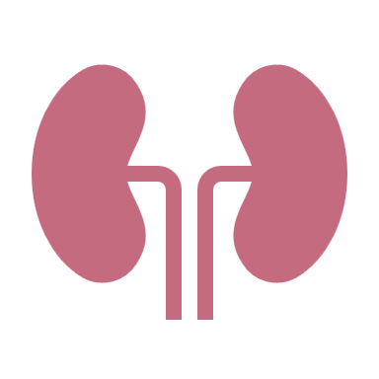
LinkedIn
Thank You
Kencin Autry
Matt Kennedy
Lily Thompson
Lapadre Proctor
Timothy Norman
Notes:
Add groups linked in info in QR code

Slide 49
Backup Slides

Slide 50
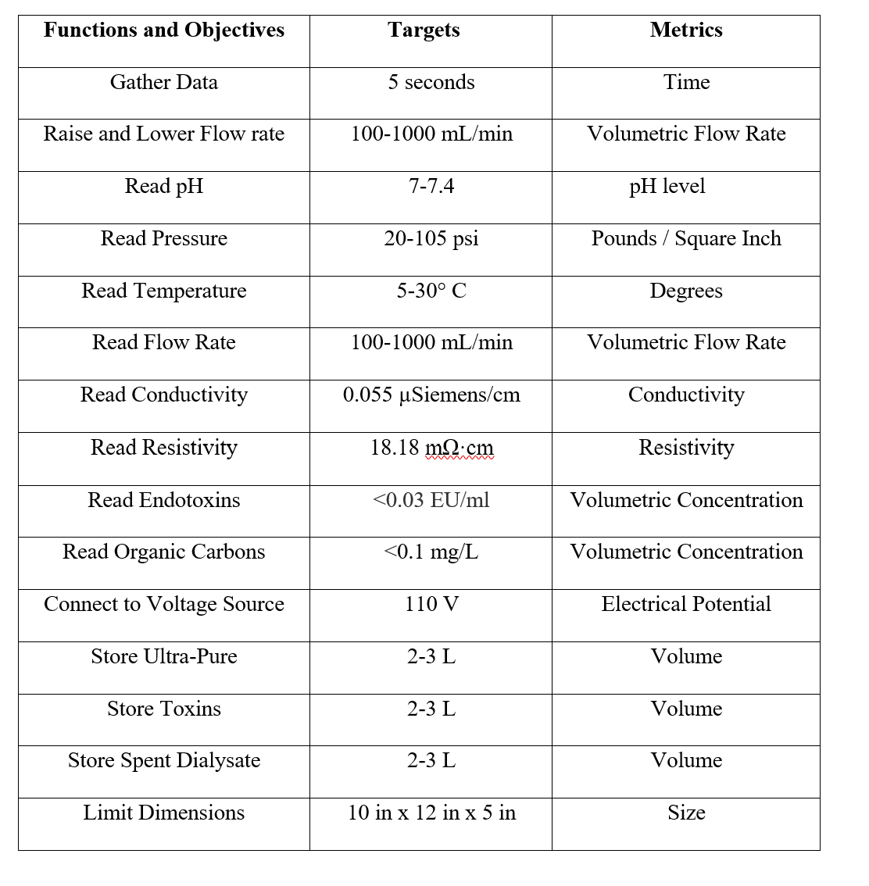
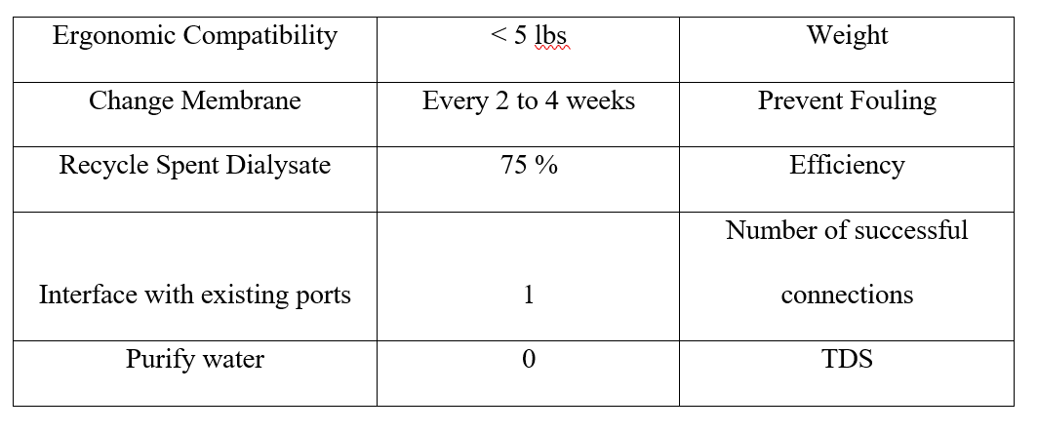
Targets and Metrics Table

Slide 51
Ultra-Pure Standards Table

Slide 52
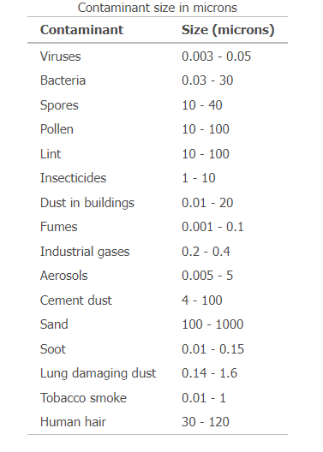
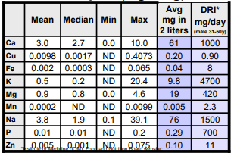
Contaminants Found in Tap Water

Slide 53
A mixed matrix (MM) CNTs membrane, on the other hand, consists of several layers of polymers or other composite material. Such membranes operate with low energy consumption due to the frictionless capacity of CNT to move water through hydrophobic hollow cavity nanotubes. The membrane is highly sensitive to multiple pollutants and salts, being permeable to antifouling, self-cleaning, reusable and good water. A brief comparison between the vertically aligned and mixed matrix CNT membranes is tabulated in Table 1.

Slide 54
Standards for Ultra-Pure Water
Ultrapure water (UPW) is water that has been purified to high levels of specification:
Extremely low total dissolved solids (TDS) level
High electrical resistivity
Free from chloride, sulfate, sodium, calcium, magnesium
Minimal levels of organic contaminants, > 1 ppb

Slide 55
Bill Of Materials
Matthew Kennedy

Slide 56
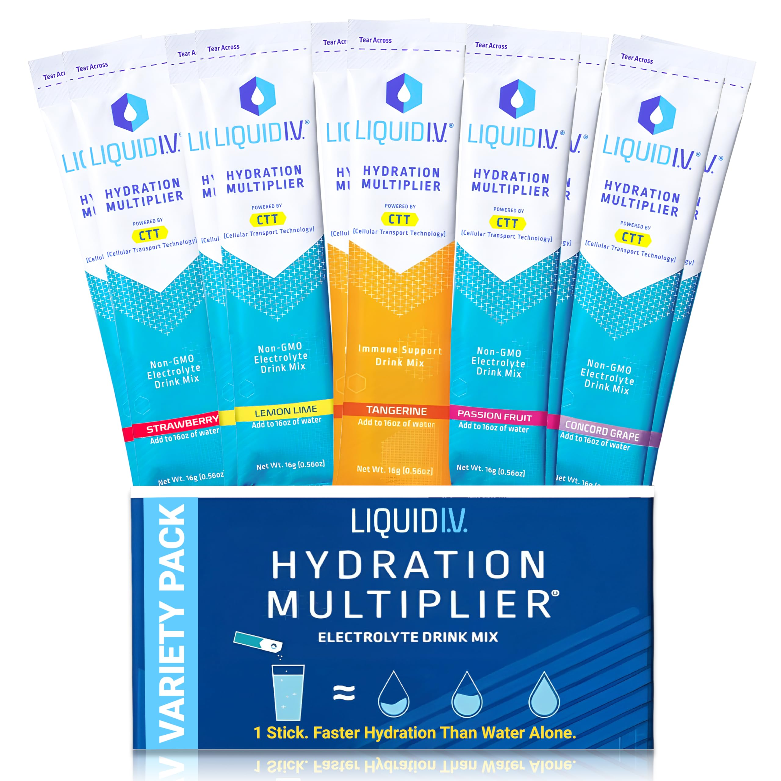
Testing Methods
Electrolyte Additives
Urea
0.6 kilograms per meter cubed
0.45 gram per liter

Slide 57
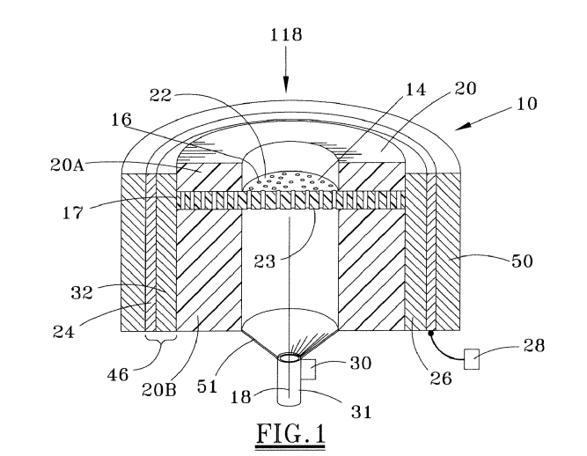
Nasa CNT and Ultrasonic Patent

Slide 58
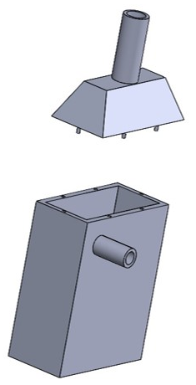
Initial vs Current Filter Prototype
Matthew Kennedy
Surrounding Shell
Ultrasonic Generator
CNT Membrane

Slide 59
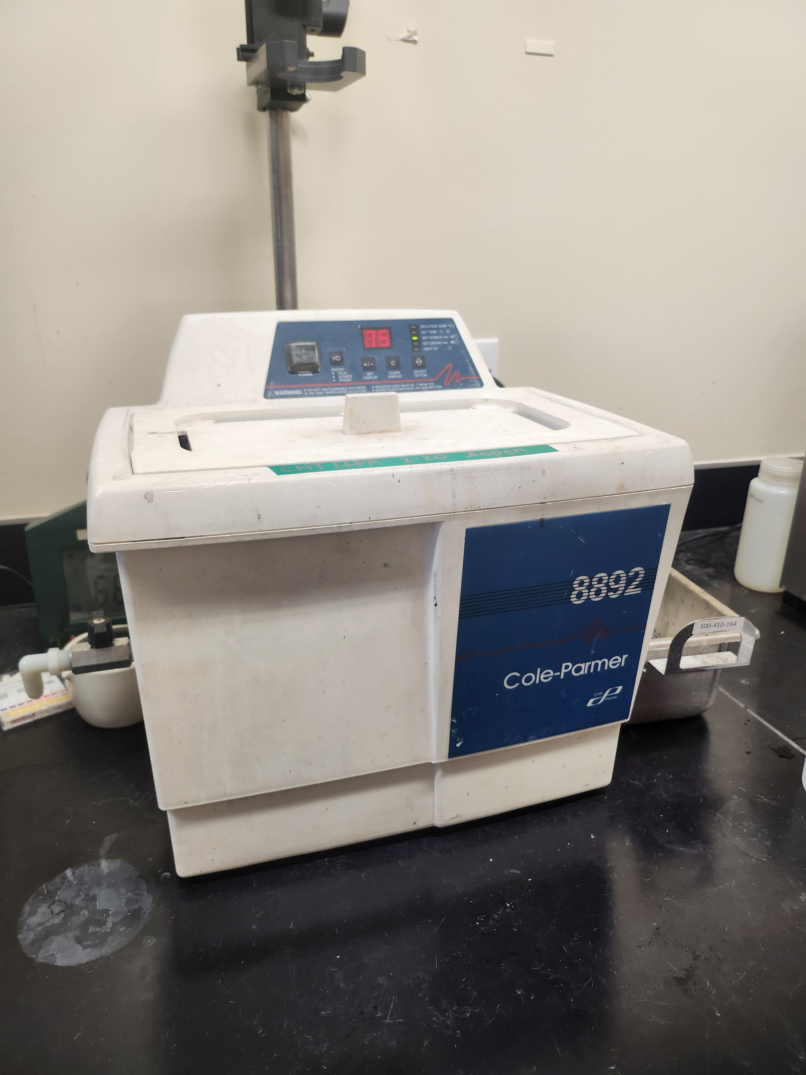

Slide 60
Fluid Computations
Lily Thompson
Key
$$A=Area$$
$$V=Velocity$$
$$P=Pressure$$
$$ρ=Density$$
$$P_{1}$$
$$V_{1}$$
?
$$A_{1}V_{1}=A_{2}V_{2}$$
?
$$P_{1}+\frac{1}{2}ρV_{1}^{2}=P_{2}+\frac{1}{2}ρV_{2}^{2}$$
$$P_{2}$$
$$V_{2}$$
$$P_{1}>P_{2}$$
$$V_{1}>V_{2}$$
Notes:
Put dimensions on here

Slide 61
Configuration
Lily Thompson
$$P_{1}$$
$$V_{1}$$
?
$$A_{1}V_{1}=A_{2}V_{2}$$
$$P_{1}>P_{2}$$
$$P_{2}$$
$$V_{2}$$
$$P_{1}+\frac{1}{2}ρV_{1}^{2}=P_{2}+\frac{1}{2}ρV_{2}^{2}$$
?
Notes:
Put dimensions on here

Slide 62
Concept Selection
Matt Kennedy
Analytical Hierarchy Process
Concept | Alternative Value
Nano-filtration and Reverse Osmosis | 0.247
Nano-filtration | 0.382
Forward Osmosis | 0.382

Slide 63
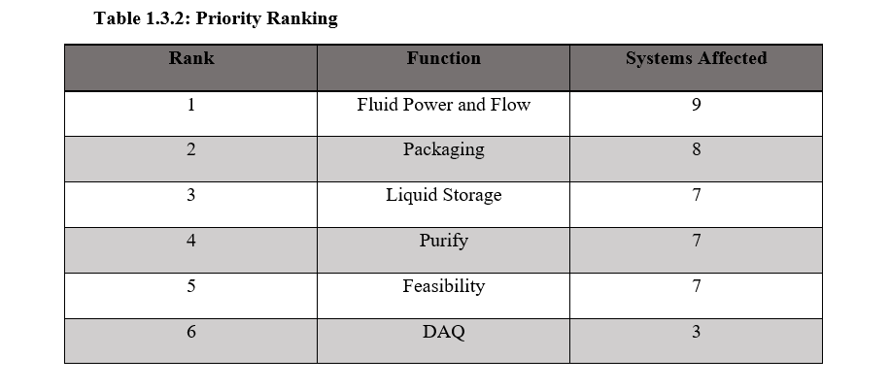
Functional Decomp Priority Rating

Slide 64
Functional Decomp Cross Reference

Slide 65
Calculations for Laminar Flow
$$ρ=1000 \frac{kg}{m^{3}} , v= ?, average diameter of a nanotube d=2.0 x {10}^{−9} ,$$
$$μ=0.0008891 \frac{N∗s}{m^{2}}$$
$Re$ = $\frac{ρvd}{μ}$
To find the velocity:
Given, by our customer, a flow rate of $1000 \frac{mL}{min}$
1000 ${mL}/{min}$ $→$ converted to $1.67 x {10}^{−5}{m^{3}}/s$
$1.67 x {10}^{−5}{m^{3}}/s$ $→$ converted to $5.32 x {10}^{3}\frac{m}{s}$
$$Re= \frac{(1000 \frac{kg}{m^{3}})(5.32 x {10}^{3}\frac{m}{s})(2.0 x {10}^{−9})}{(0.0008891 \frac{N∗s}{m^{2}})}$$
$Re≈12$, indicating a Laminar Flow

Slide 66
What a Dialyzer Looks Like

Slide 69
Hemodialysis and Peritoneal
Hemodialysis is ongoing dialysis (3 to 5 times a week) that cleans your blood, usually in a dialysis center. The hemodialysis access is in your arm.
Peritoneal dialysis is ongoing dialysis (daily) that collects waste from the blood by washing the empty space in the abdomen (peritoneal cavity). It can be done from home. The access for this is in your abdomen.

Slide 70
Reasons Why
The spent dialysate is a highly saline liquid consisting of urea, creatinine, uric acid, phosphate, etc.
A major challenge for the reuse of spent dialysate is removal of urea, the main nitrogenous waste product.
Due to its small molecular weight (60 Da) and electroneutral nature, it is difficult to be removed by sorbents.
Key Drawbacks:
System complexity
High energy cost
Membrane fouling and scaling

Slide 71
Current System Schematic
Kencin Autry
Ultra-Pure Runoff
Dialysis Machine
Water Supply
Filter
Dialysate Runoff
Notes:
*include specific parts we’ve ordered
Water supply will need to include the RO system
Filter will need to to be the CNT membrane
Pumps and piping being used

Slide 72
Timothy Norman
Primary Markets
Hospitals and Medical Care Facilities
At-home patients
72

Slide 73
Results
Produced 3 sheets of CNTs all with equal thickness
CNTs were hydrophobic
No filtration capabilities
Due to nature of entangled CNTs
Notes:
Produced 3 sheets of CNTs all with equal thickness
The plan was to have three grates inside the housing and comparatively test better filtration with placing one by one inside
But..
Explain why we thought it failed
CNTs were hydrophobic
No filtration capabilities
Nature of randomly dispersed CNTs

Slide 74
Timothy Norman
Secondary Markets
Nursing and Retirement Care
Pharmaceuticals
City Water Treatment
Food Manufacturing
74

Slide 77
Notes:
Filter process design

Slide 79
Lily Thompson
Assumptions
Hemodialysis and peritoneal will be the main medical processes the system is used for
The system will only be used by one patient at a time
The incoming flow is laminar
79

Slide 80
Lily Thompson
Assumptions
Hemodialysis and peritoneal will be the main medical processes the system is used for
The system will only be used by one patient at a time
The incoming flow is laminar
80

Slide 81
College of Engineering Color Palette
1 2 3 4
Pantone: PMS 195 C
RGB: 120, 47, 64
Hex: #782F40
CMYK:19, 90, 50, 55
1 2 3 4
Pantone: Black C
RGB: 0, 0, 0
Hex: #000000
CMYK:0, 0, 0, 100
Garnet
Black
1 2 3 4
RGB: 238, 118, 36
Hex: #EE7624
CMYK:2, 66, 99, 0
1 2 3 4
Pantone: PMS 000C
RGB: 255, 255, 255
Hex: #FFFFFF
CMYK: 0, 0, 0, 0
Fang
Orange
White
Notes:
Avoid 75% Black in B135

Slide 82
Accent Color Palette
1 2 3 4
RGB: 0, 59, 111
Hex: #003B6F
CMYK:
1 2 3 4
RGB: 0, 59, 111
Hex: #003B6F
CMYK:
1 2 3 4
RGB: 251, 236, 93
Hex: #FBEC5D
CMYK:
1 2 3 4
RGB: 219, 215, 210
Hex: #DBD7D2
CMYK:
1 2 3 4
RGB: 251, 236, 93
Hex: #FBEC5D
CMYK:
1 2 3 4
RGB: 219, 215, 210
Hex: #DBD7D2
CMYK:
Tardis Blue
Tardis Blue
Corn
Timberwolf
Corn
Timberwolf
1 2 3 4
RGB: 206, 0, 88
Hex: #CE0058
CMYK: 0, 100, 43, 12
1 2 3 4
RGB: 206, 0, 88
Hex: #CE0058
CMYK: 0, 100, 43, 12
1 2 3 4
RGB: 104, 40, 96
Hex: #682860
CMYK:
1 2 3 4
RGB: 220, 220, 220
Hex: #DCDCDC
CMYK:
Rubine Red
Rubine Red
Imperial
Gainsboro
1 2 3 4
RGB: 72, 146, 155
Hex: #48929b
CMYK:
1 2 3 4
RGB: 64, 224, 208
Hex: #40E0D0
CMYK:
1 2 3 4
RGB: 255, 139, 0
Hex: #FF8B00
CMYK:
Asagi-iro
Turquoise
American Orange
Notes:
Remove American orange add hyperlink grey
Make corn the last for b135
All work in 134 imperial move later
Tardis doesn’t work in b136

Slide 83
F7AB19
D67F15
EE7624
D64615
F73119
Analogous
https://color.adobe.com/create/color-wheel
6E3610
F0A16C
EE7624
6E4931
BASB1C
Monochromatic
A14508
4BED3B
EE7624
250CED
2010A1
Triad
A1470C
FF8C40
EE7624
0098A1
24E2ED
Complementary
28A164
2FED8D
EE7624
0848A1
1871ED
Split Complementary
EDAC2F
3BED93
EE7624
0C6AED
ED2F18
Double Split Complementary
ED660C
C7ED3B
EE7624
0CE1ED
A418ED
Square
BA7E09
87724A
EE7624
60EFCF
09BA61
Compound
AD551A
6E3610
EE7624
FA7625
D46820
Shades
Notes:
These are the variants that work well with Fang Orange. The bolded items show well on the projectors.

Slide 84
85412D
8F3831
782f40
8F3176
792D85
Analogous
https://color.adobe.com/create/color-wheel
C44D69
8E626D
782F40
C48796
451B25
Monochromatic
C43959
78743B
782F40
236178
43A2C4
Triad
C43959
C46078
782F40
25C43D
2F783A
Complementary
93C460
577835
782F40
39C49D
297861
Split Complementary
784435
5A783B
782F40
237860
6E2978
Double Split Complementary
782337
78683b
782F40
237830
293978
Square
AB4D32
DEBAAF
782F40
5D8555
70AB32
Compound
38161E
C44D69
782F40
853447
5E2532
Shades

Slide 85
A105
A105
B135 Stage Left
B135 Stage Right
B136
B134, A105
B135

Slide 91
Logos and icons

Slide 92
Citations
blood dialysis by Andy Horvath from <a href="https://thenounproject.com/browse/icons/term/blood-dialysis/" target="_blank" title="blood dialysis Icons">Noun Project</a> (CC BY 3.0)
Kidney by Febrian Hidayat from <a href="https://thenounproject.com/browse/icons/term/kidney/" target="_blank" title="Kidney Icons">Noun Project</a> (CC BY 3.0)
Dialysis Machine by bsd studio from <a href="https://thenounproject.com/browse/icons/term/dialysis-machine/" target="_blank" title="Dialysis Machine Icons">Noun Project</a> (CC BY 3.0)
Dialysis Machine by Gan Khoon Lay from <a href="https://thenounproject.com/browse/icons/term/dialysis-machine/" target="_blank" title="Dialysis Machine Icons">Noun Project</a> (CC BY 3.0)
filter by Smalllike from <a href="https://thenounproject.com/browse/icons/term/filter/" target="_blank" title="filter Icons">Noun Project</a> (CC BY 3.0)
filter by Kiran Shastry from <a href="https://thenounproject.com/browse/icons/term/filter/" target="_blank" title="filter Icons">Noun Project</a> (CC BY 3.0)
filter by Kiran Shastry from <a href="https://thenounproject.com/browse/icons/term/filter/" target="_blank" title="filter Icons">Noun Project</a> (CC BY 3.0)
Waste by lastspark from <a href="https://thenounproject.com/browse/icons/term/waste/" target="_blank" title="Waste Icons">Noun Project</a> (CC BY 3.0)
Waste by lastspark from <a href="https://thenounproject.com/browse/icons/term/waste/" target="_blank" title="Waste Icons">Noun Project</a> (CC BY 3.0)
Adapter by mynamepong from <a href="https://thenounproject.com/browse/icons/term/adapter/" target="_blank" title="Adapter Icons">Noun Project</a> (CC BY 3.0)
Outlet by Darrin Loeliger from <a href="https://thenounproject.com/browse/icons/term/outlet/" target="_blank" title="Outlet Icons">Noun Project</a> (CC BY 3.0)
Water Filter by I Putu Dicky Adi Pranatha from <a href="https://thenounproject.com/browse/icons/term/water-filter/" target="_blank" title="Water Filter Icons">Noun Project</a> (CC BY 3.0)
Water Filter by Phonlaphat Thongsriphong from <a href="https://thenounproject.com/browse/icons/term/water-filter/" target="_blank" title="Water Filter Icons">Noun Project</a> (CC BY 3.0)
water treatment by Soremba from <a href="https://thenounproject.com/browse/icons/term/water-treatment/" target="_blank" title="water treatment Icons">Noun Project</a> (CC BY 3.0)
water treatment by Soremba from <a href="https://thenounproject.com/browse/icons/term/water-treatment/" target="_blank" title="water treatment Icons">Noun Project</a> (CC BY 3.0)
Faucet by Uswa KDT from <a href="https://thenounproject.com/browse/icons/term/faucet/" target="_blank" title="Faucet Icons">Noun Project</a> (CC BY 3.0)
IV Bag by Ralf Schmitzer from <a href="https://thenounproject.com/browse/icons/term/iv-bag/" target="_blank" title="IV Bag Icons">Noun Project</a> (CC BY 3.0)
Reservoir by Adrien Coquet from <a href="https://thenounproject.com/browse/icons/term/reservoir/" target="_blank" title="Reservoir Icons">Noun Project</a> (CC BY 3.0)

Slide 93
Citations
R. Nystrand Microbiology of water and fluids for hemodialysis J. Chin. Med. Assoc., 71 (5) (2008), pp. 223-229
J.W.M. Agar Conserving water in and applying solar power to haemodialysis: ’Green Dialysis’ through wiser resource utilization Nephrology, 15 (4) (2010), pp. 448-453
https://www.umms.org/ummc/health-services/kidney/dialysis/types#:~:text=Hemodialysis%20is%20ongoing%20dialysis%20(3,can%20be%20done%20from%20home.

